Slide 1

WELCOME TO
YEAR 3
Willow Class
NAME OF TEACHERS:
Mrs Irvine & Mrs Ali

Slide 2

Adults in the classroom
Class teacher – Mrs Irvine (Monday, Tuesday, Wednesday afternoon & Mrs Ali (Thursday, Friday)
Mrs Haque – Wednesday mornings
Mrs Byer – Humanities on a Thursday
LSA – Mrs Saidani (Monday-Wednesday)
Mrs Allen (Thursday-Friday)

Slide 3


Morning reminders
Punctuality - playground gates will be open from 8.45am and will be locked promptly at 9am. If you are arriving after this time you will need to ring the buzzer at Reception.
As soon as children arrive, they should proceed to their classroom where their teacher will be waiting with morning work to complete.

Slide 4

Attendance
Regular school attendance is key to children learning and reaching their full potential.
If your child is not going to be in, please phone the school office ASAP.

Slide 5
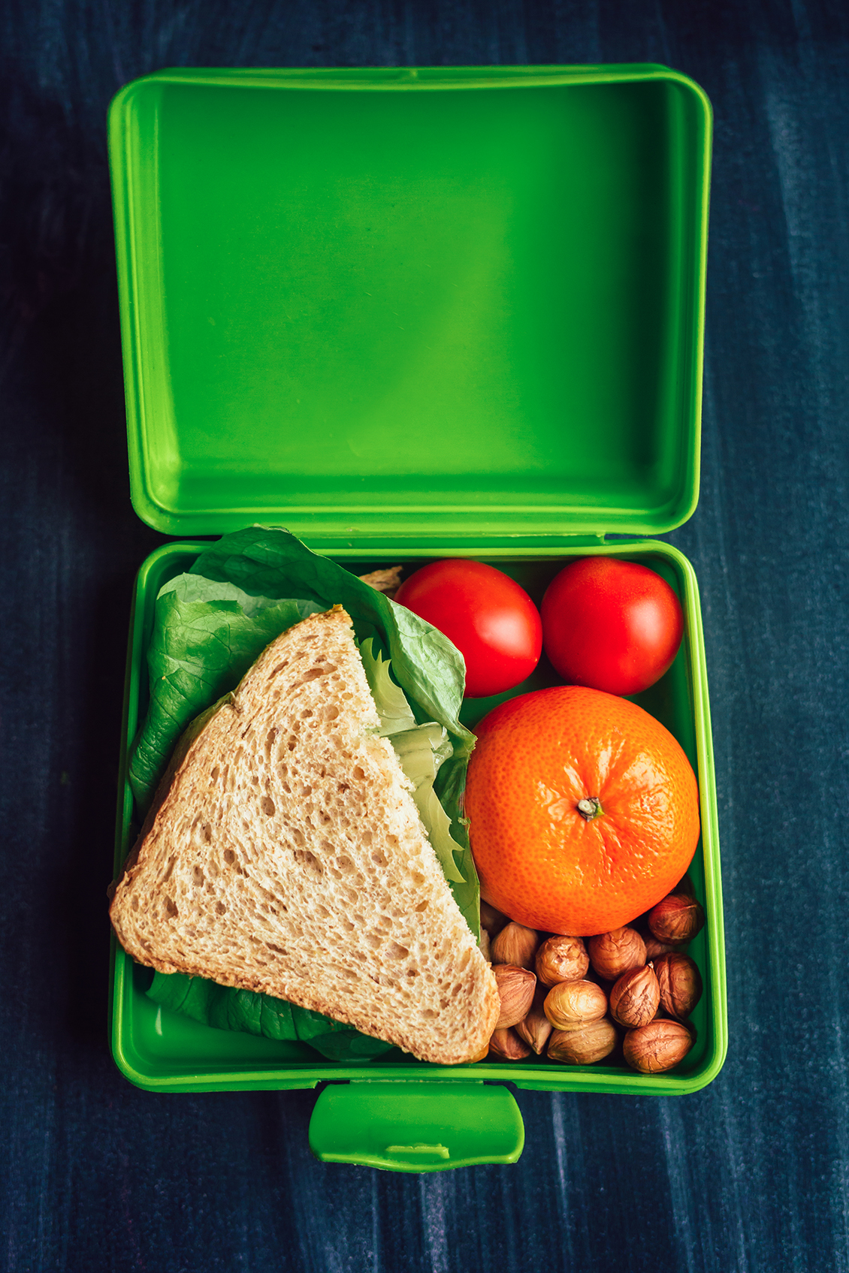

Break and lunchtimes
Children can bring in their own healthy snack in for break time.
Hot dinners are available to children when requested. They should be ordered a week in advance. They are also able to have packed lunches. All children sit together in the dining hall in mixed year groups (Y3 sit with Y4).
Healthy eating is important at our school; sandwiches, fruit or vegetables, yoghurt and a small biscuit is ample in a packed lunch. We are a nut free school – no nut products are to be brought into school.

Slide 6

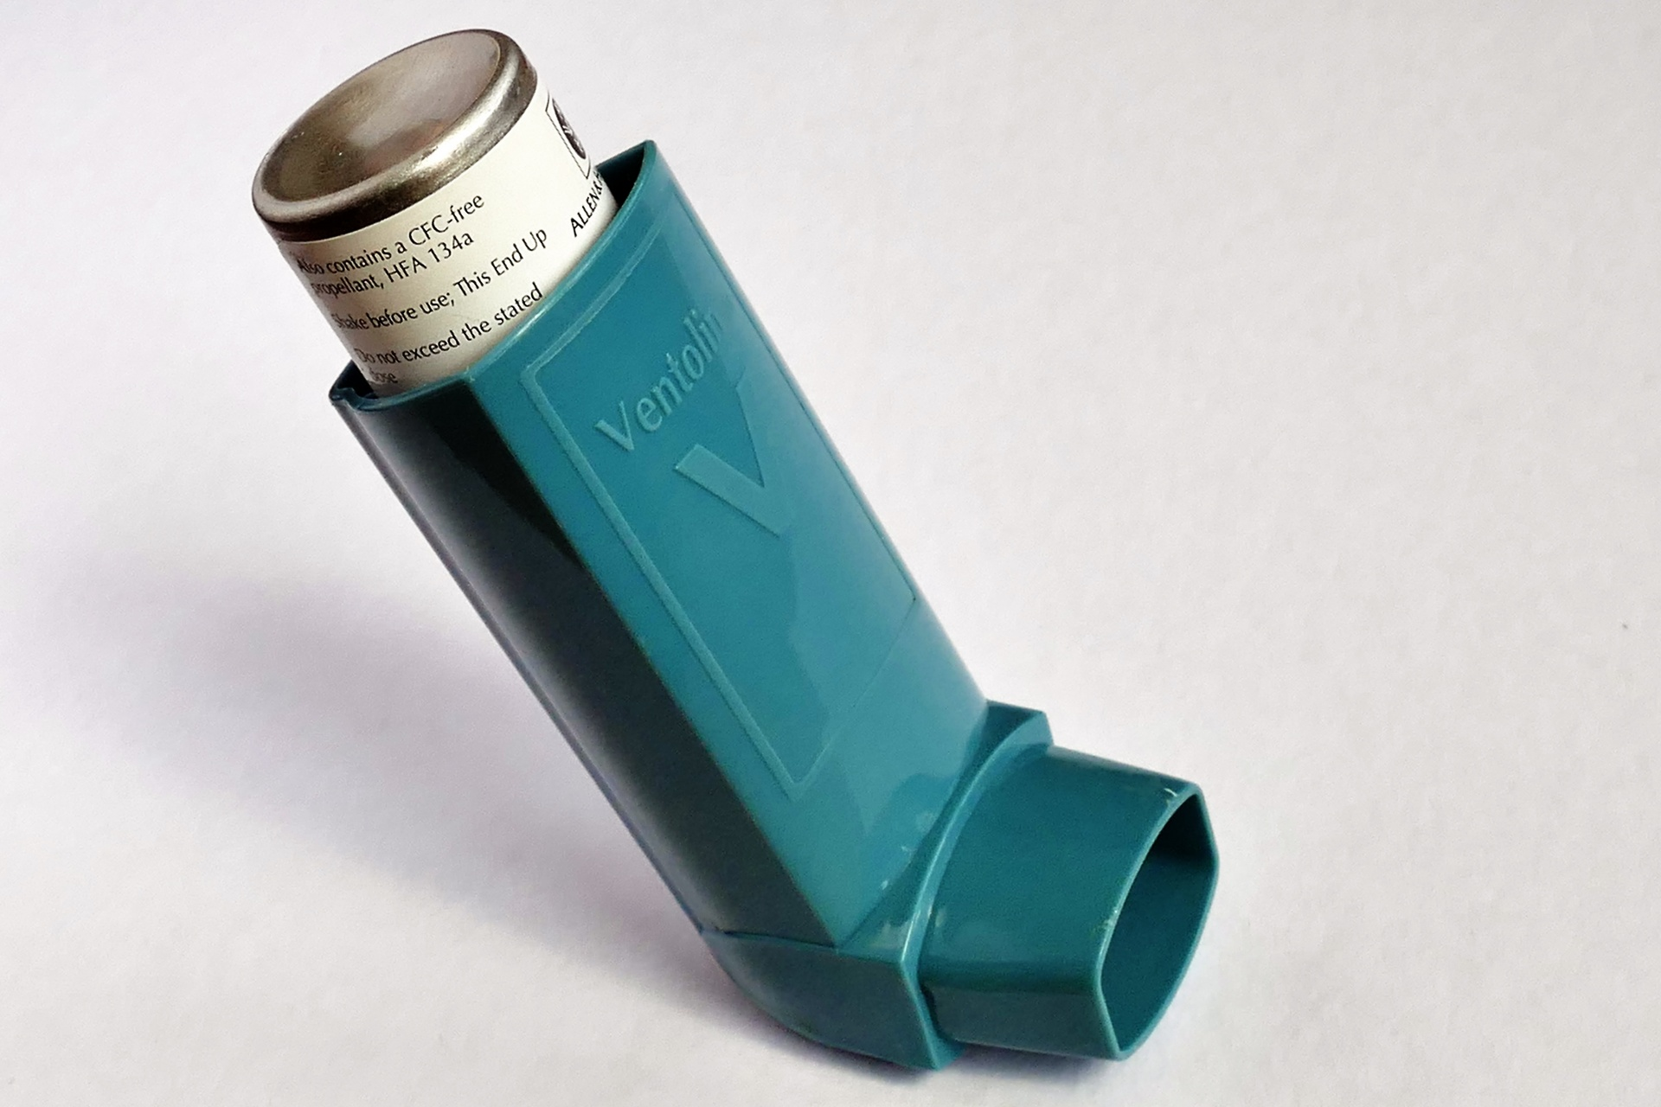
In the classroom
Rewards - Tokens for reward trolley, marbles, verbal praise, sharing assembly certificates.
Sanctions – Clear, consistent consequences displayed in classroom.
Water bottles - named please
Medication (inhalers/EPI pens to be named and in date)
Please do not bring in pencil cases, toys or precious items, these will spend the day on our desk. All equipment is provided in school.

Slide 7


Uniform
Clearly labelled uniform, it does not need to have a logo.
PE kit needs to be worn to school on child’s PE day and
MUST be clearly labelled. Our PE days are Mondays and Fridays.
If hair is long enough to be tied up, it must be. Please can children wear plain hair bands/ clips.
Earrings must be plain studs and only one in each ear. They are not permitted to be worn during PE. For the first 6 weeks they may be covered with tape (which the child will have to apply and provide). After which, children must manage removing the earrings themselves.

Slide 8

Communication
Reading diaries are managed by the children but will be checked by an adult in school on a Friday – if you write a message in there, make sure your child lets us know.
There is always a teacher on duty at the start of the day.
Parents can speak to us at the end of the day or get a message to us through the office.
Do we have your up-to-date contact details?
Parent Evenings are being held on Wednesday 18th November (3:30-7pm) and Thursday 19th November (3:30-5pm)

Slide 9
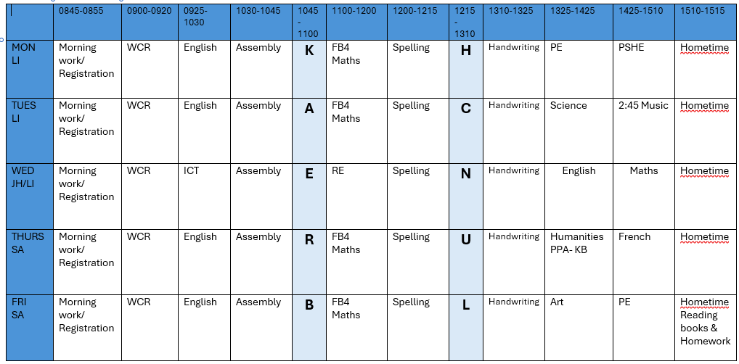
Timetable

Slide 10


Homework in Year 3
Please try to read with your child every night. Please sign and date the reading diary. The reading diary needs to come into school every day please as it is stamped every time children read with an adult. Books are changed every Friday.
Every Friday, your child will receive a piece of maths homework along with a piece of English homework or a reading comprehension. These will be a consolidation of work taught in school. Please try to give your child time to complete and support them if they need it. Allow no more than 20 minutes. Please do come and see us if you have any questions or concerns. Homework is due in on Wednesdays please.
Your child has their own Times Tables Rockstars login - it will be stuck in their maths homework book.

Slide 11


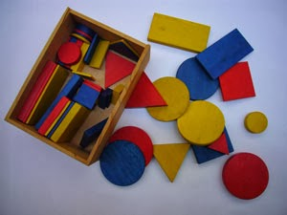

Maths
Daily maths lessons are following the White Rose scheme. Daily keep-up sessions to keep children on track. We work hard to challenge and support each child.
The first term focusses on Place Value and Addition & Subtraction.
Challenge and problem solving included in maths lessons are linked to everyday situations e.g money, time, weighing and measuring.
Lots of different concrete resources in the classroom for the children to use within their lessons.

Slide 12




English
Daily English lessons in which each child has a teacher guided
session weekly. We follow the Ready Steady Write Scheme. The first half term will focus on the book 'The Iron Man' by Ted Hghes.
We work hard to challenge and support each child.
We put a strong emphasis on presentation and encourage all children to take pride in their work.
Spelling, grammar and punctuation teaching is implemented throughout English lessons.
We continue to have a whole school focus on handwriting. We are using the Kinetic Letters programme.

Slide 13

Reading
Please read with your child every day. Daily reading should take place every day (10 – 20 mins). Please keep hearing your child read and continue to sign and date the reading diary. Reading books should be in school every day for reading opportunities with an adult.
Books are changed every Friday.
Daily Whole Class Reading sessions. Our first book of the year is 'The Worst Witch' by Jill Murphy.
We are continually assessing children’s reading to ensure they are at the correct level.
Comprehension, not just de-coding. If you would like to be a reading helper or would like support with reading strategies for your child, please contact us or Mrs Byer.
Please encourage your child to read at home to develop their love of reading.

Slide 14
Assessment and Parent Interviews
Your child's progress will be regularly evaluated throughout the year, using both formal and informal assessments. We will administer summative, nationally recognised tests in Reading, SPaG and Maths to monitor progress, alongside ongoing teacher assessments.
For Writing, teachers will assess work based on National Curriculum criteria.
During Parent-Teacher Interviews, we will share your child's progress and achievement.
During the Autumn term, these interviews will be held on:
Wednesday 18^{h} November – Thursday 19th November 2024

Slide 15
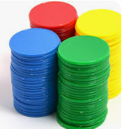

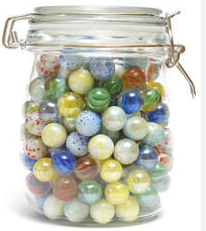

Behaviour and Expectations
At Foxes Piece, we expect and encourage good behaviour and self discipline from all pupils in order to achieve an environment which enables emotional development, effective learning, high standards and the smooth functioning of the school as an orderly community.
How do we maintain this?
By reinforcing our strong values regularly
Praise pupils for good behaviour by positive phrasing, giving tokens for children to collect and spend on the Token Trolley, collect marbles for a Marble Treat, Whole school Sharing Assembly and certificates for pupil’s achievements and successes.

Slide 16
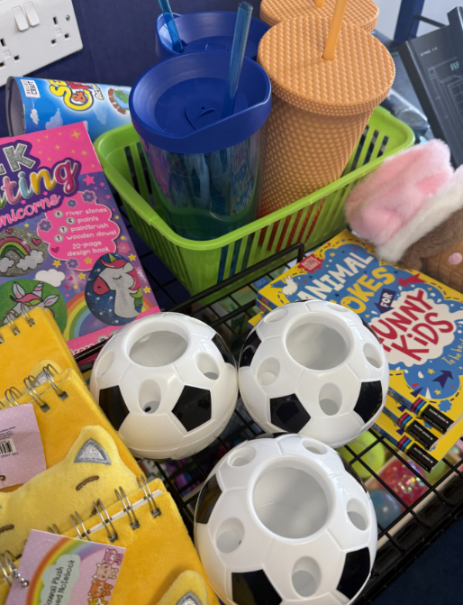
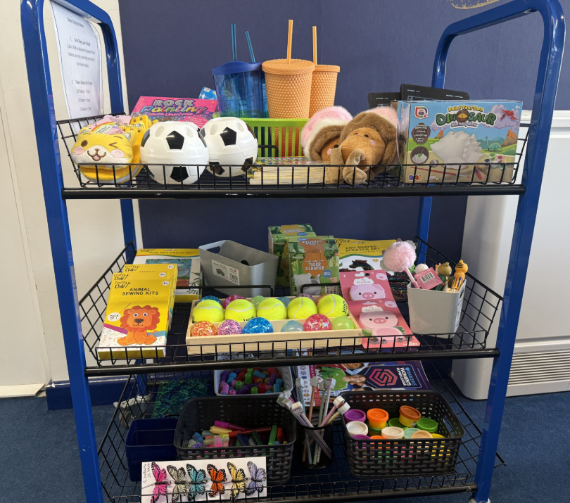
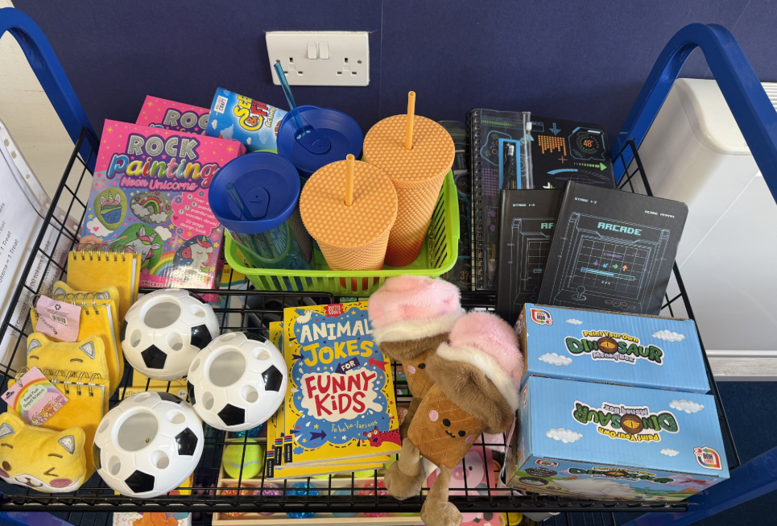
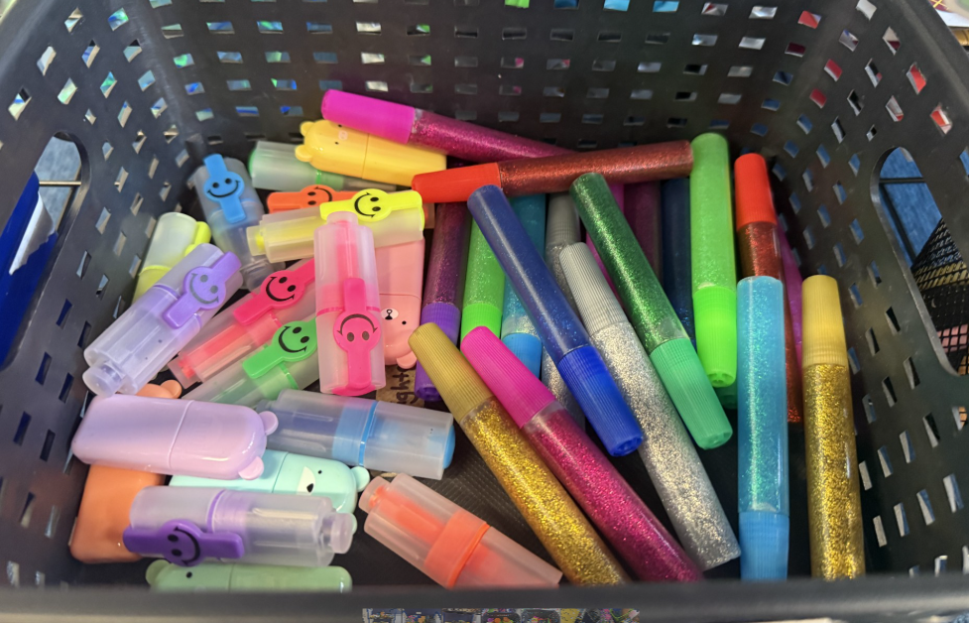
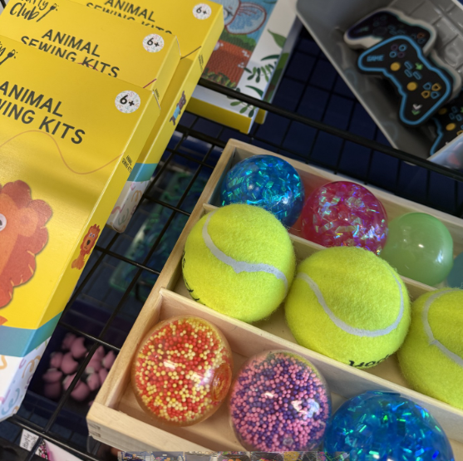
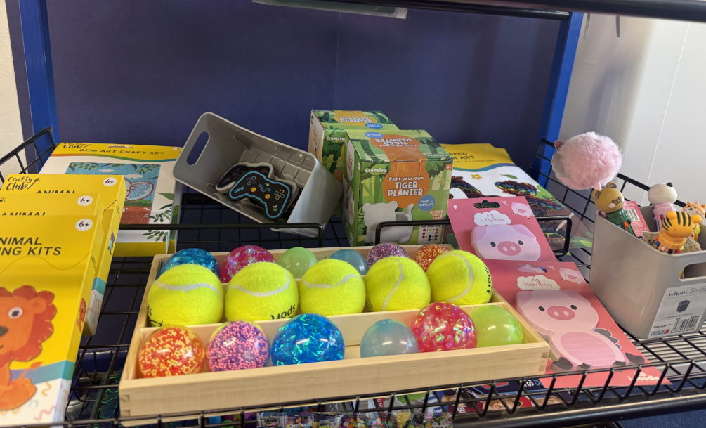
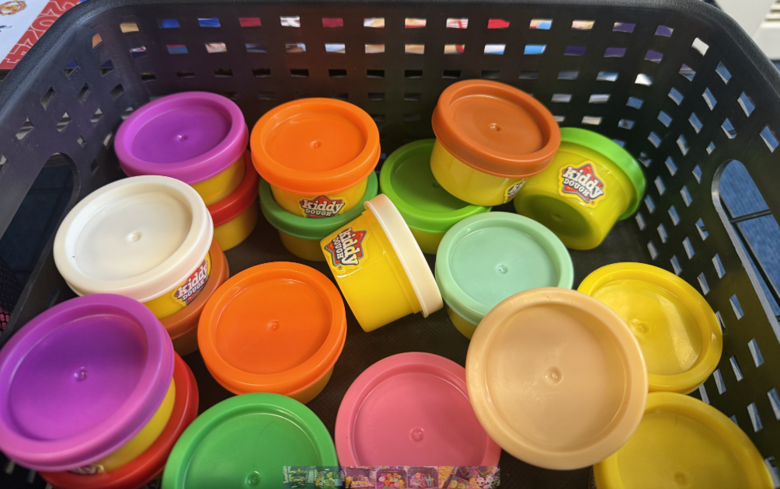
Token Trolley

Slide 17
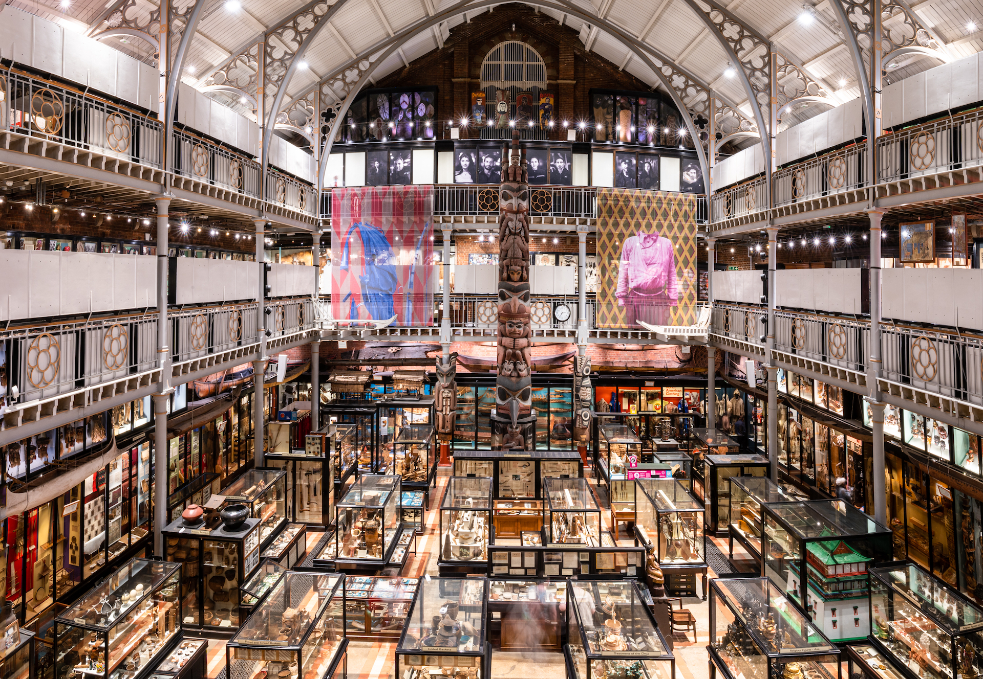
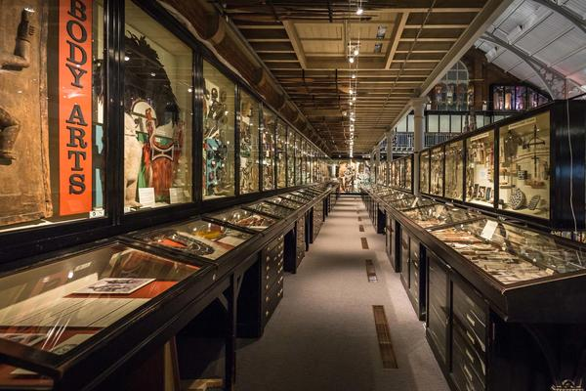
School Trips
In Year 3 we will aim to plan a trip or experience day each term.
So far, we have booked a Stone Age workshop at the Pitts River Museum in Oxford on Wednesday 21st October.
With rising costs of trips and coach hire, we will be creative in delivering trip experiences for the children to ensure they still have a fun and engaging day!

Slide 18
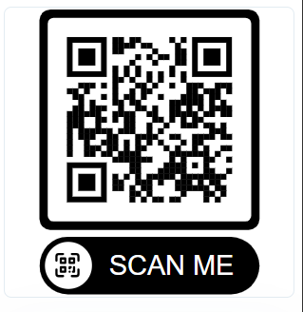
NEW COMMUNICATION TOOL
Eduspot
Eduspot is our free parent app, available on iOS and Android. It allows you to receive school messages, reply to the school, view upcoming events and make online payments – all in one place.
Search “Eduspot” in your app store or visit:
parents.eduspot.co.uk
Please ensure the school has your current email address and mobile number so that you can log in. Scan the QR code to get started.

Slide 19
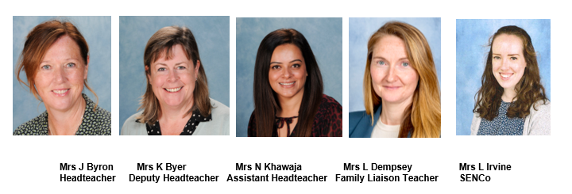
Safeguarding
The Designated Leaders for Safeguarding (DSL) are Mrs Jane Byron, Mrs Karen Byer. Mrs Nazia Khawaja, Mrs Lisa Dempsey and Mrs Loren Irvine are additional DSLs.
At Foxes Piece, the health, safety and well-being of every child is of paramount concern. We listen to our pupils and take seriously what they tell us. Our aim is that children will enjoy their time as pupils in our school.
We want to work in partnership with everyone to help children achieve their full potential and make a positive contribution.
For all safeguarding related queries please email -
safeguarding@foxespiece.co.uk

Slide 20

Thank you!
If you would like to volunteer to work at Foxes Piece, please contact the school office. We are always very appreciative of any extra help!
Any questions?
We look forward to working with you and your children this year.
Thank you for attending this meeting.

