Slide 1

WELCOME TO
YEAR 4
SYCAMORE

Slide 2

Meet the Year 4 Team
Miss. Lightfoot– Class Teacher
Mrs. Haque - (Tuesday mornings)
Mrs. Hedges – LSA (Monday – Wednesday)
Mr. Lockwood– LSA (Thursday & Friday)

Slide 3

Morning Reminders
Punctuality - playground gates will be open
from 8.45am and will be locked promptly at
8:55am. If you are late, you will need to ring
the buzzer at Reception and sign the late
book.
As soon as children arrive they should
proceed to their classroom ready for their day.

Slide 4

Attendance
Regular school attendance is essential if children are to achieve their full potential.
We believe that regular school attendance is the key to enabling children to maximise the educational opportunities available to them and become emotionally resilient, confident and competent adults who are able to realise their full potential and make a positive contribution to their community.
As a school, we class 96% or above attendance as good attendance. Attendance is monitored regularly and support is available as needed.

Slide 5
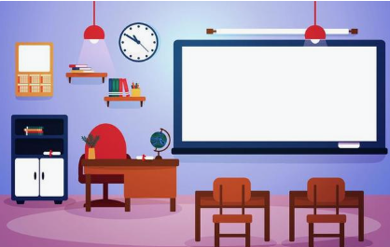
Daily Routine
As soon as children arrive to school, they should proceed to their classroom ready to start the morning work.
Morning work consists of maths questions and/or silent reading.
Reading records and books should be handed in every day into the box.

Slide 6
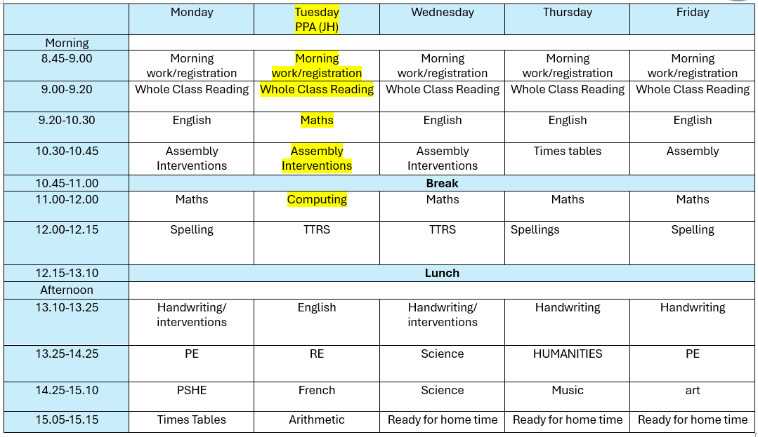
Timetable

Slide 7



The Year 4 Reading Spine
Autumn 1: The Girl Who Stole an Elephant
This term we are reading The Girl Who Stole an Elephant. We have a class set for the whole class to use one each.
Chaya, a no-nonsense, outspoken hero, leads her friends and a gorgeous elephant on a noisy, fraught, joyous adventure through the jungle where revolution is stirring and leeches lurk. Will stealing the queen's jewels be the beginning or the end of everything for the intrepid gang?

Slide 8
School Values
Our vision and values are at the core of everything we do. They underpin our teaching and learning and provide an environment which prepares our pupils as confident, happy citizens.
Our Values: Resilience, Equality, Independence, Respect and Kindness.
Mission Statement - To provide the highest quality all round education, for each and every child, in partnership with parents, within our diverse community.
Aim - To create a happy, safe and curious learning community.
Purpose/Vision - At Foxes Piece School pupils will leave resilient, confident, respectful and independent young people, ready for their next step in education.
Resilience, Equality, Independence, Respect, Kindness.

Slide 9
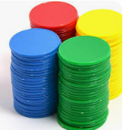

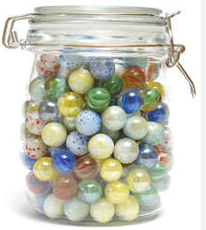

Behaviour and Expectations
At Foxes Piece, we expect and encourage good behaviour and self discipline from all pupils in order to achieve an environment which enables emotional development, effective learning, high standards and the smooth functioning of the school as an orderly community.
How do we maintain this?
By reinforcing our strong values regularly
Praise pupils for good behaviour by positive phrasing, giving tokens for children to collect and spend on the Token Trolley, collect marbles for a Marble Treat, Whole school Sharing Assembly and certificates for pupil’s achievements and successes.

Slide 10
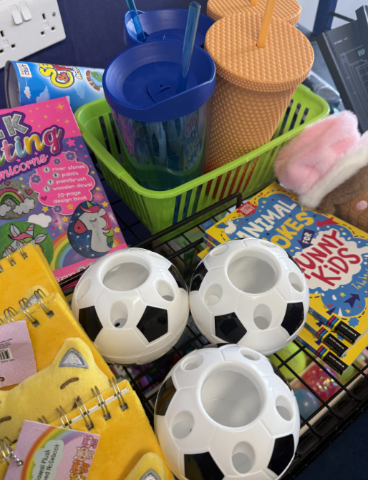
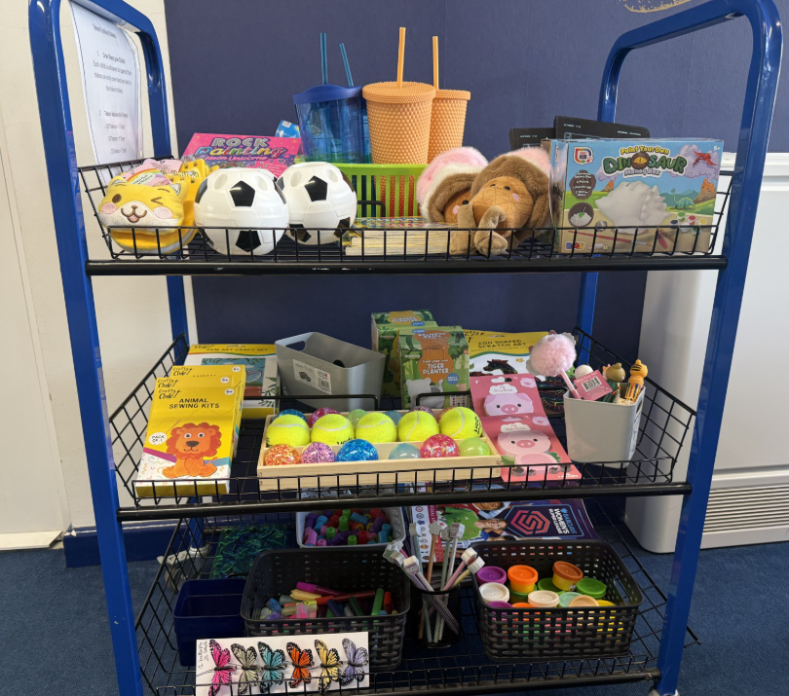
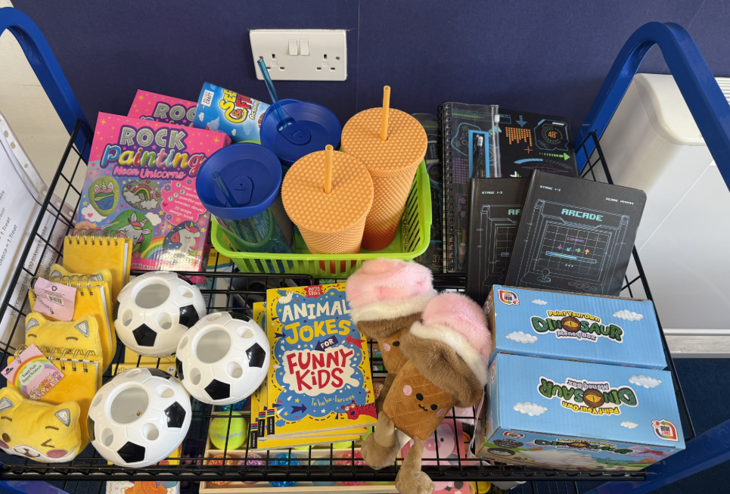
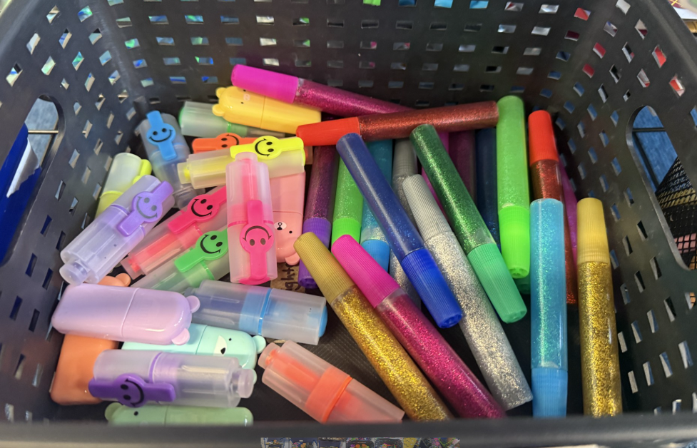
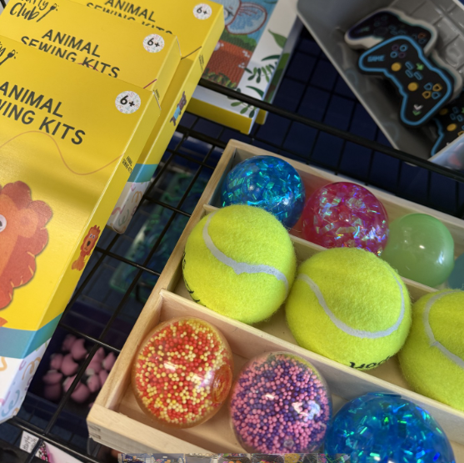
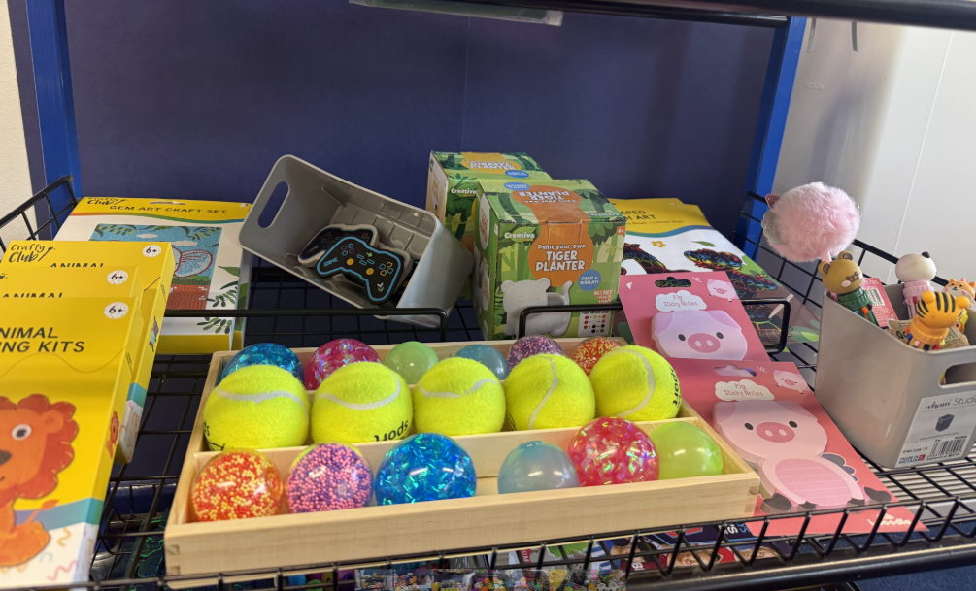
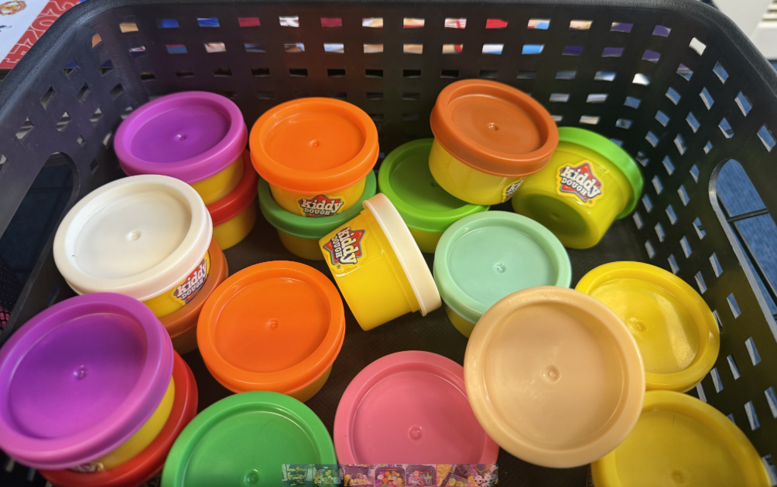
Token Trolley

Slide 11

BREAK AND LUNCHTIMES
Children can bring in their own healthy snack for breaktime.
Hot dinners are available to children when requested and paid for in advance. They are also able to have packed lunches. All children sit together in the canteen.
Lunches and snacks provided from home should help to promote a balanced and healthy approach to food and diet.
  We are a nut free school – no nut products to be brought into school.

Slide 12


Uniform and PE Days
- Please can school uniform be clearly labelled.
PE uniform needs to be worn to school on child’s PE day and must be clearly labelled.
PE days in Year 4 are Monday and Friday.
- If hair is long enough to be tied up, it must be. Please
can children wear plain hair bands/ clips.
- Earrings must be plain studs and only one in each
ear. They are not permitted to be worn during PE. For
the first 6 weeks after a new piercing, they should be covered with tape (which the child will have to apply and provide).

Slide 13
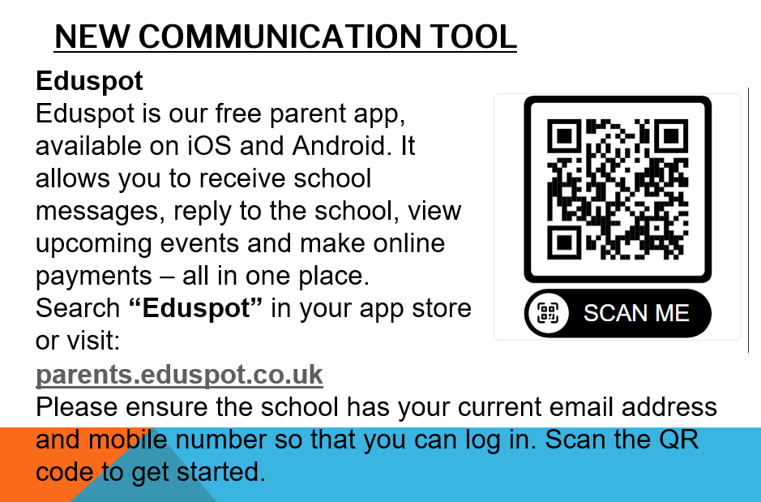

Slide 14
Assessment and Parent Interviews
Your child's progress will be regularly evaluated throughout the year, using both formal and informal assessments. Teachers will administer summative, nationally recognised tests in Reading and Maths to monitor progress, alongside ongoing teacher assessments.
For Writing, teachers will assess work based on National Curriculum criteria.
During Parent-Teacher Interviews, teachers will share your child's progress and achievement. These interviews will be held on:
Wednesday 18th & Thursday 19th November 2026.

Slide 15


Homework in Year 4
Daily reading should take place every day Please keep hearing your child read and continue to sign and date the reading diary. Reading books should be in school every day for reading opportunities with an adult.
Children can access Doodle Maths and Times Table Rock Stars. Children can find their logins in their homework book.
Once a week, children will receive an English and Maths based homework. Homework will be set on Thursday and returned back to school on Tuesday
Please support your child to find a suitable time and day to complete homework, ready to hand in on time.

Slide 16
Multiplication Tables Check (MTC)
Takes place in June 2027
The children need to be able to answer their times tables 1-12 in 5 seconds per question.
We will be practising in school regularly using both TTRS and physcial paper quizzes.
We would like the children to practise at home using Times Table Rockstars.

Slide 17
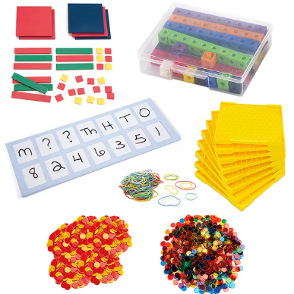

Maths
We teach Maths daily following the White Rose scheme. We work hard to challenge and support each child.
Challenge and problem solving is included in Maths lessons and linked to everyday situations e.g money, time, weighing and measuring.
Children can access Doodle Maths and Times Table Rock Stars in school and at home.

Slide 18



English
We teach daily English lessons following Ready, Steady, Write scheme. Grammar and punctuation teaching is implemented throughout English lessons.
Spelling lessons follow Ready, Steady Spell scheme.
Daily Guided Reading sessions are taught (group or whole class).
We put a strong emphasis on presentation and encourage all children to take pride in their work. We have implemented a new handwriting scheme – Kinetic Letters.
We work hard to challenge and support each child.

Slide 19

READING
Please read with your child every day. Reading books are changed by the children when needed and should be in school everyday.
We are continually assessing children’s reading to ensure they are at the correct level.
Please encourage your child to read at home to develop their love of reading.
At Foxes Piece we have a passion for reading and each classroom has their own reading corner. Children can choose a book from our reading corner or the Key Stage 2 Library.

Slide 20
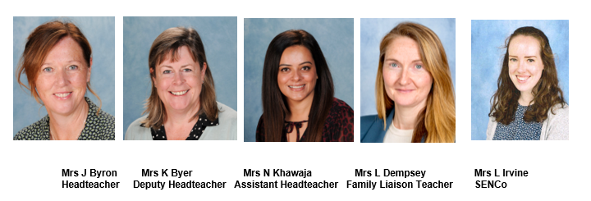
Safeguarding
The Designated Leaders for Safeguarding (DSL) are Mrs Jane Byron, Mrs Karen Byer, Mrs Nazia Khawaja, Mrs Lisa Dempsey and Mrs Loren Irvine are additional DSLs.
At Foxes Piece, the health, safety and well-being of every child is of paramount concern. We listen to our pupils and take seriously what they tell us. Our aim is that children will enjoy their time as pupils in our school.
We want to work in partnership with everyone to help children achieve their full potential and make a positive contribution.
For all safeguarding related queries please email -
safeguarding@foxespiece.co.uk

Slide 21
Thank you!
If you would like to volunteer to work at Foxes Piece, please contact the school office. We are always very appreciative of any extra help!
Any questions?
We look forward to working with you and your children this year.
Thank you for attending this meeting.

