Slide 1

WELCOME TO
YEAR 6
SILVER BIRCH

Slide 2

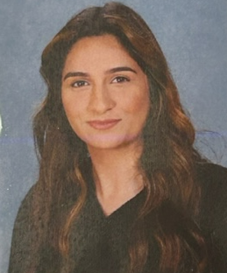
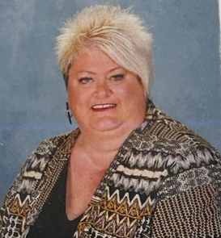
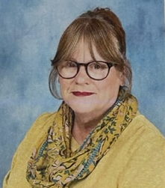
Meet the Year 6 Team
Silver Birch Class Teachers:
Miss Saeed – Class teacher (Mon - Fri)
Supporting Staff:
Mrs Savory LSA: Tuesday – Friday
Miss Plumridge LSA: Monday – Thursday
Mr Lockwood LSA: Monday – Wednesday
Mr Chapman LSA: Friday

Slide 3

Morning Reminders
Punctuality - playground gates will be open from 8.45am and will be locked promptly at 8:55am. If you are late, you will need to ring the buzzer at Reception and sign the late book.
As soon as children arrive they should proceed to their classroom ready for their day.

Slide 4

Attendance
Regular school attendance is essential if children are to achieve their full potential.
We believe that regular school attendance is the key to enabling children to maximise the educational opportunities available for them to become emotionally resilient, confident and competent adults, who are able to realise their full potential and make a positive contribution to their community.
As a school, we class attendance at 96% or above as good. Attendance is monitored regularly and support is available as needed.

Slide 5









Daily Routine
As soon as children arrive to school, they should proceed to their classroom ready to start their morning work. Morning work consists of arithmetic and grammar questions. This is an essential part of the day to allow children to recall their prior learning.

Slide 6
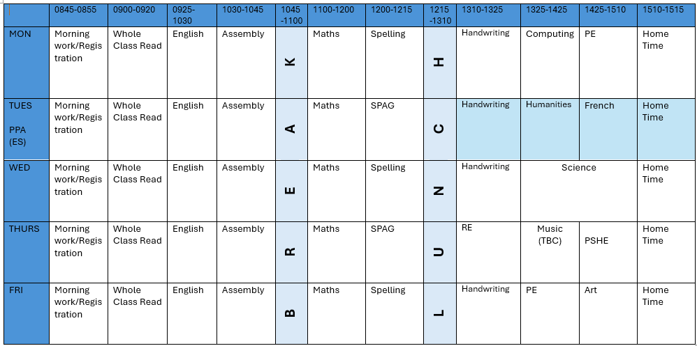
Year 6 Timetable

Slide 7










The Year 6 Reading Spine
Autumn 1: Wonder by R J Palacio
This term we are reading the novel Wonder by R J Palacio. We have a class set so all children are able to follow along. We make sure at the end of each day the children have the opportunity to hear someone read aloud. We also use this time to allow the children to answer VIPER questions to support their reading comprehension skills.
Here are some more novels from the year 6 reading spine.

Slide 8

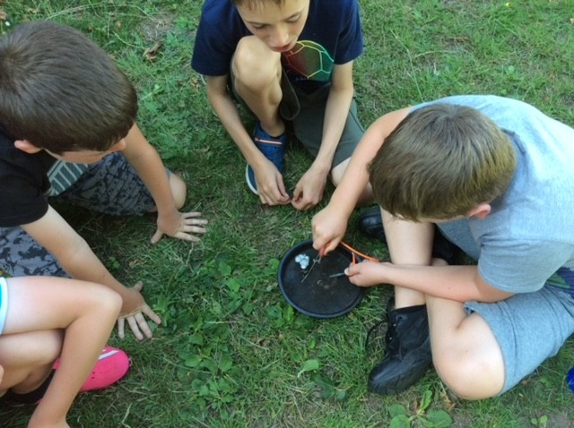
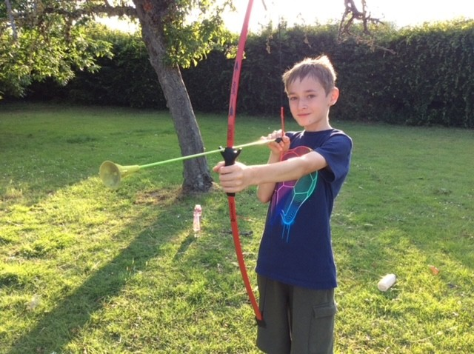
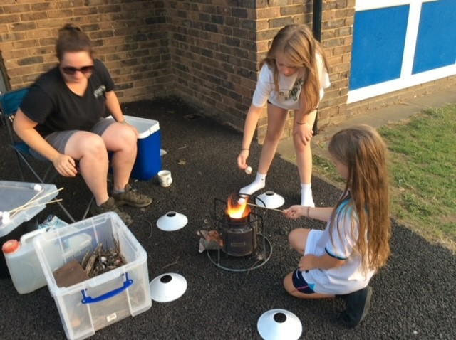
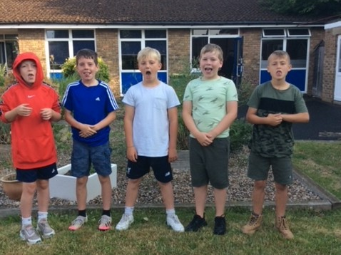
Year 6 Camping trip:
Organising a camping trip previously was a great success! As a result, we would loved to offer this experience again to our hard working pupils.
This experience allowed children to learn a range of new skills! – some of the activities include archery, fire lighting and survival games.
More information about the date and payment will be sent out soon.

Slide 9
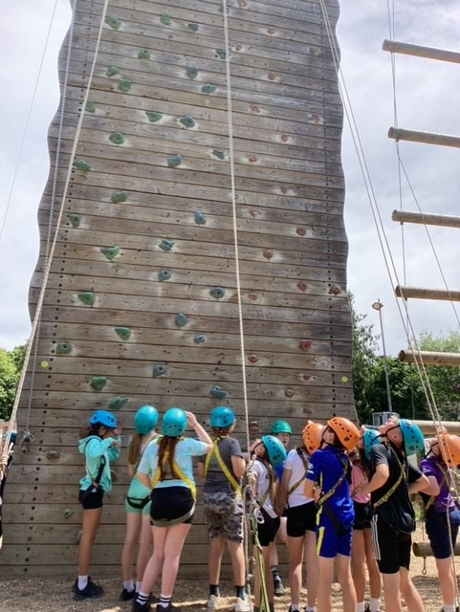
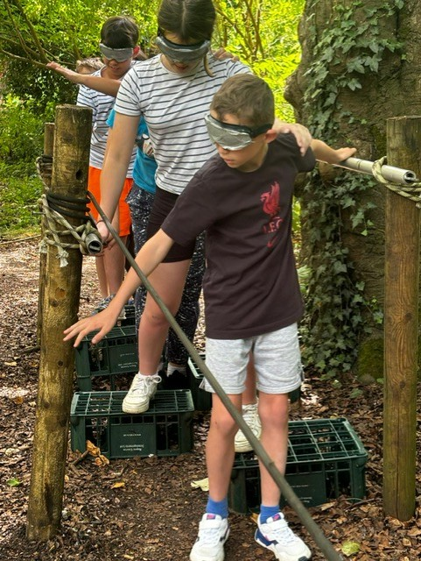
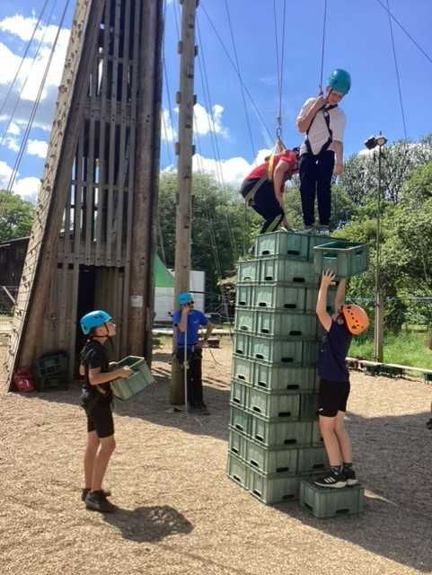
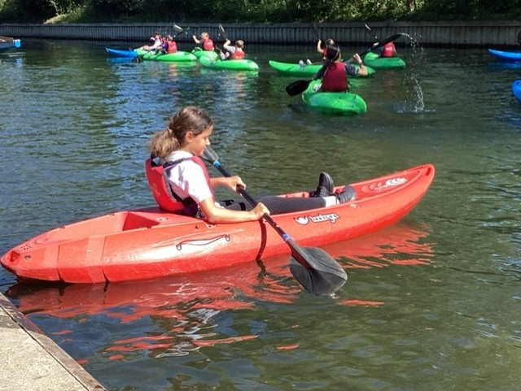
Longridge
Towards the end of Year 6, we reward their hard work and resilience with a trip to Longridge, which will take place over 2 days.
More information about the trip (cost and itinerary) will be given closer to the time. Payment plans will also be available for families from January.

Slide 10
School Values
Our vision and values are at the core of everything we do. They underpin our teaching and learning and provide an environment which prepares our pupils as confident, happy citizens.
Our Values: Resilience, Equality, Independence, Respect and Kindness.
Mission Statement - to provide the highest quality all round education, for each and every child, in partnership with parents, within our diverse community.
Aim - To create a happy, safe and curious learning community.
Purpose/Vision - At Foxes Piece School pupils will leave resilient, confident, respectful and independent young people, ready for their next step in education.
Resilience, Equality, Independence, Respect, Kindness.

Slide 11
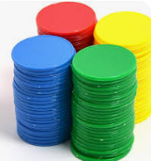

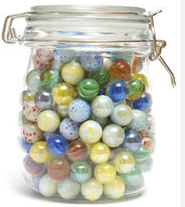

Behaviour and Expectations
At Foxes Piece, we expect and encourage good behaviour and self discipline from all pupils in order to achieve an environment which enables emotional development, effective learning, high standards and the smooth functioning of the school as an orderly community.
How do we maintain this?
By reinforcing our strong values regularly
Praise pupils for good behaviour by positive phrasing, giving tokens for children to collect and spend on the Token Trolley, collect marbles for a Marble Treat, Whole school Sharing Assembly and certificates for pupil’s achievements and successes.

Slide 12
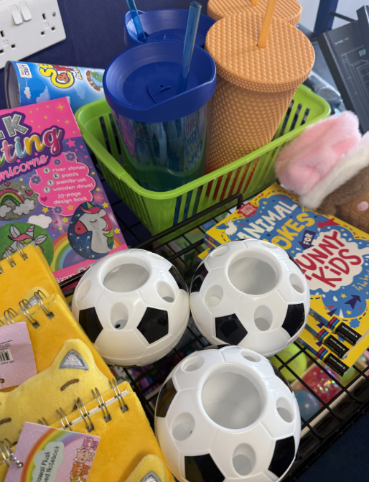
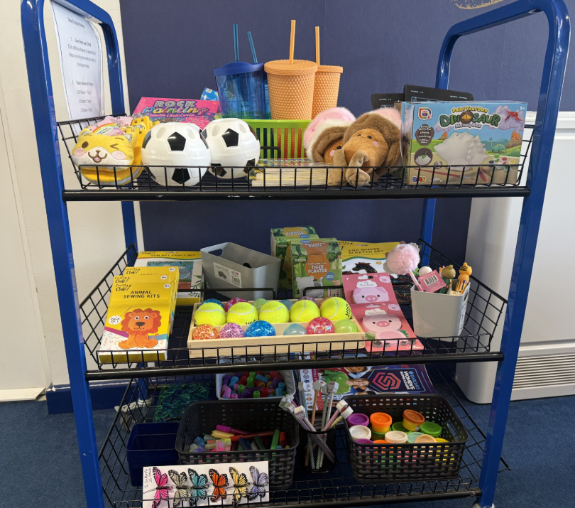
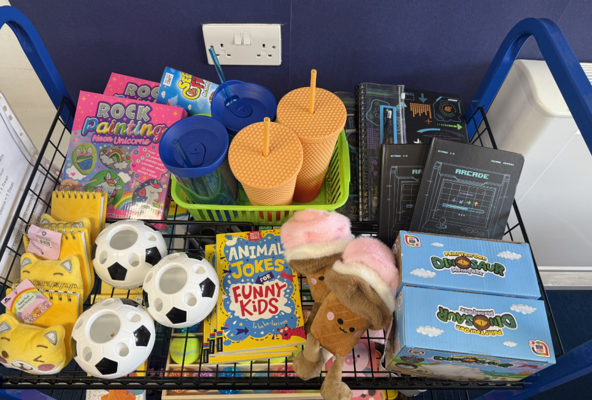
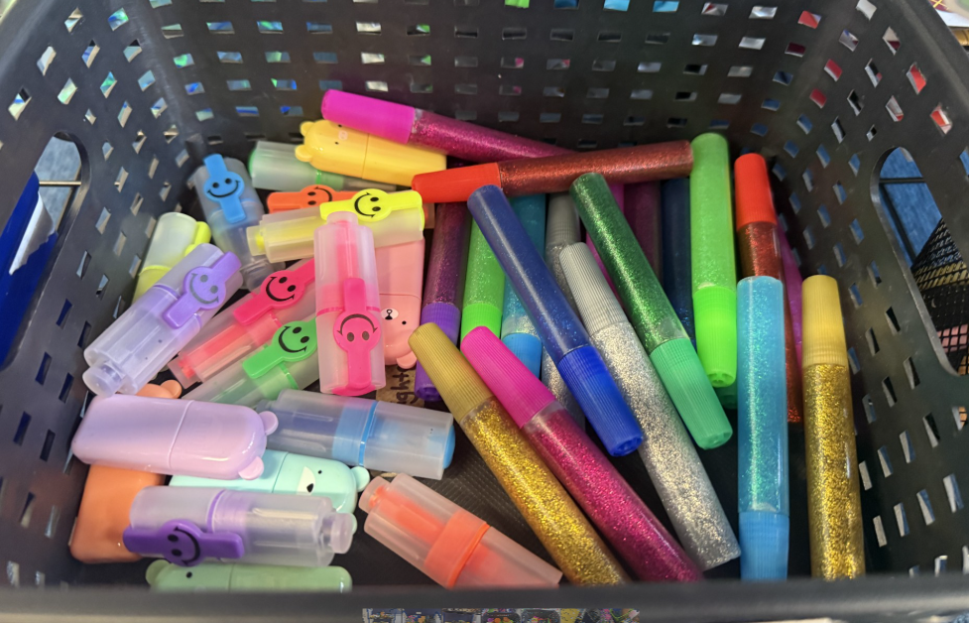
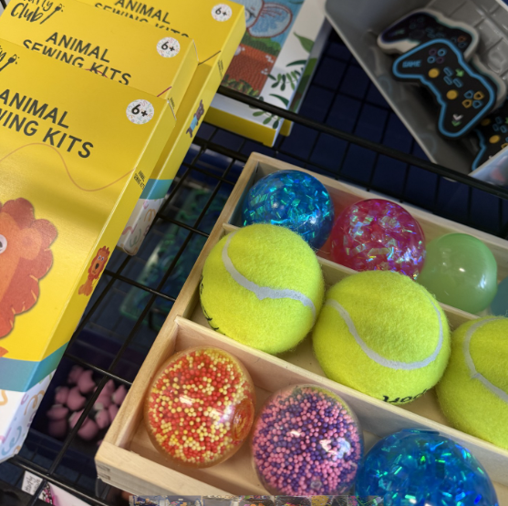
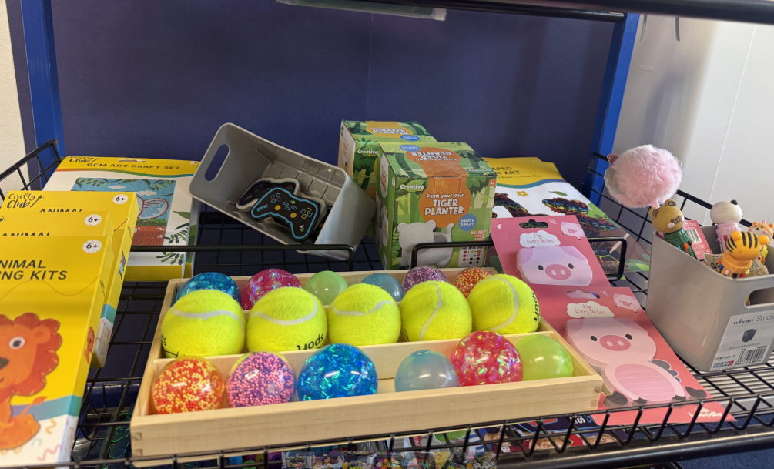
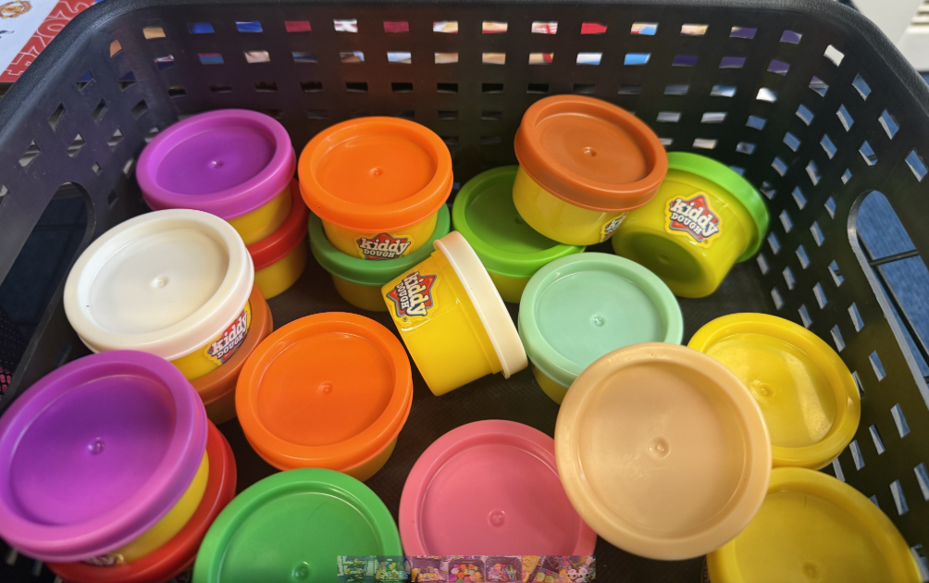
Token Trolley

Slide 13

BREAK AND LUNCHTIMES
Fruit is available in the dining hall at break times. Children can bring in their own healthy snack.
Hot dinners are available to children when requested and paid for in advance. They are also able to have packed lunches. All children sit together in The Hungry Fox dining hall in mixed year groups.
Lunches and snacks provided from home should help to promote a balanced and healthy approach to food and diet.
  We are a nut free school – no nut products to be brought into school.

Slide 14

Uniform and PE Days
- Please can school uniform be clearly labelled.
PE uniform needs to be worn to school on child’s PE day and must be clearly labelled.
PE days in Year 6 are Monday and Friday.
- If hair is long enough to be tied up, it must be. Please
can children wear plain hair bands/clips.
- Earrings must be plain studs and only one in each
ear. They are not permitted to be worn during PE. For
the first 6 weeks after a new piercing, they should be covered with tape (which the child will have to apply and provide).

Slide 15

COMMUNICATION
Open communication between home and school is crucial. If you have any concerns or anything you would like to discuss regarding your child, please do not hesitate to speak to us. We are here to help.
Parents can speak to teachers at the end of the day or send a message via the office.
office@foxespiece.co.uk
Do we have your up-to-date contact details?
Look out for weekly newsletters for diary dates and important updates on school events and activities.

Slide 16
Assessment and Parent Interviews
Your child's progress will be regularly evaluated throughout the year, using both formal and informal assessments. Teachers will administer summative, nationally recognised tests in Reading and Maths to monitor progress, alongside ongoing teacher assessments.
For Writing, teachers will assess work based on National Curriculum criteria.
During Parent-Teacher Interviews, teachers will share your child's progress and achievement. These interviews will be held on:

Slide 17

Homework in Year 6
Daily reading should take place every day (10 – 20 mins). Please keep hearing your child read. Reading books should be in school every day for reading opportunities with an adult. Children are able to change their books on a daily basis when in school.
Children can access Doodle Maths and Times Table Rock Stars.
Once a week, children will receive an English and Maths based homework. Homework will be set on Friday and returned back to school on Wednesday.
Spellings will be sent home weekly.
Please support your child to find a suitable time and day to complete homework and ready to hand in on time.

Slide 18


Maths
We teach Maths daily following the White Rose scheme. We work hard to challenge and support each child.
Challenge and problem solving is included in Maths lessons and linked to everyday situations e.g money, time, weighing and measuring.
There are lots of different equipment in the classroom for the children to use, including a Maths Mastery Box.
Children can access Doodle Maths and Times Table Rock Stars in school and at home.

Slide 19



English
We teach daily English lessons following Ready, Steady, Write scheme. Grammar and punctuation teaching is implemented throughout English lessons.
Spelling lessons follow Ready, Steady Spell scheme.
Daily Guided Reading sessions are taught (group or whole class).
We put a strong emphasis on presentation and encourage all children to take pride in their work. We have implemented a new handwriting scheme – Kinetic Letters.
We work hard to challenge and support each child.

Slide 20

READING
Please read with your child every day. Reading books are changed by the children when needed and should be in school everyday.
We are continually assessing children’s reading to ensure they are at the correct level.
Please encourage your child to read at home to develop their love of reading.
At Foxes Piece we have a passion for reading and each classroom has their own reading corner. Children can choose a book from our reading corner or the Key Stage 2 Library.

Slide 21
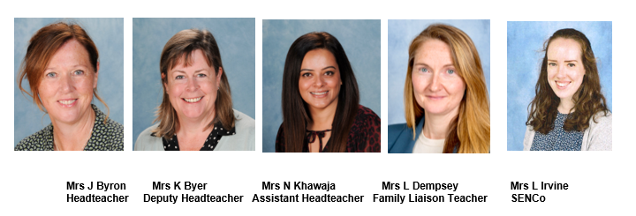
Safeguarding
The Designated Leaders for Safeguarding (DSL) are Mrs Jane Byron, Mrs Karen Byer, Mrs Nazia Khawaja, Mrs Lisa Dempsey and Mrs Loren Irvine are additional DSLs.
At Foxes Piece, the health, safety and well-being of every child is of paramount concern. We listen to our pupils and take seriously what they tell us. Our aim is that children will enjoy their time as pupils in our school.
We want to work in partnership with everyone to help children achieve their full potential and make a positive contribution.
For all safeguarding related queries please email -
safeguarding@foxespiece.co.uk

Slide 22


Online communication and gaming
Ensuring the safety of our children is our priority and as a school we are dedicated to making children feel like they are in a safe space when at school. Although we have a diverse curriculum that covers many aspects such as online safety, we urge all parents to still actively monitor your child's online interactions. By staying vigilant, we can prevent any unkind communication and can create a safer digital space for the children.
Remember if you have any concerns, you can always contact the school for support and advice.
You can also contact NSPCC, who are available 11am to 5pm Monday – Friday or email on help@NSPCC.org.uk

Slide 23
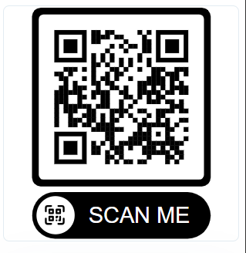
NEW COMMUNICATION TOOL
Eduspot
Eduspot is our free parent app, available on iOS and Android. It allows you to receive school messages, reply to the school, view upcoming events and make online payments – all in one place.
Search “Eduspot” in your app store or visit:
parents.eduspot.co.uk
Please ensure the school has your current email address and mobile number so that you can log in. Scan the QR code to get started.

Slide 24
Thank you!
If you would like to volunteer to work at Foxes Piece, please contact the school office. We are always very appreciative of any extra help!
Any questions?
We look forward to working with you and your children this year.
Thank you for attending this meeting.

