Slide 1



WELCOME TO RECEPTION
OAK CLASS

Slide 2
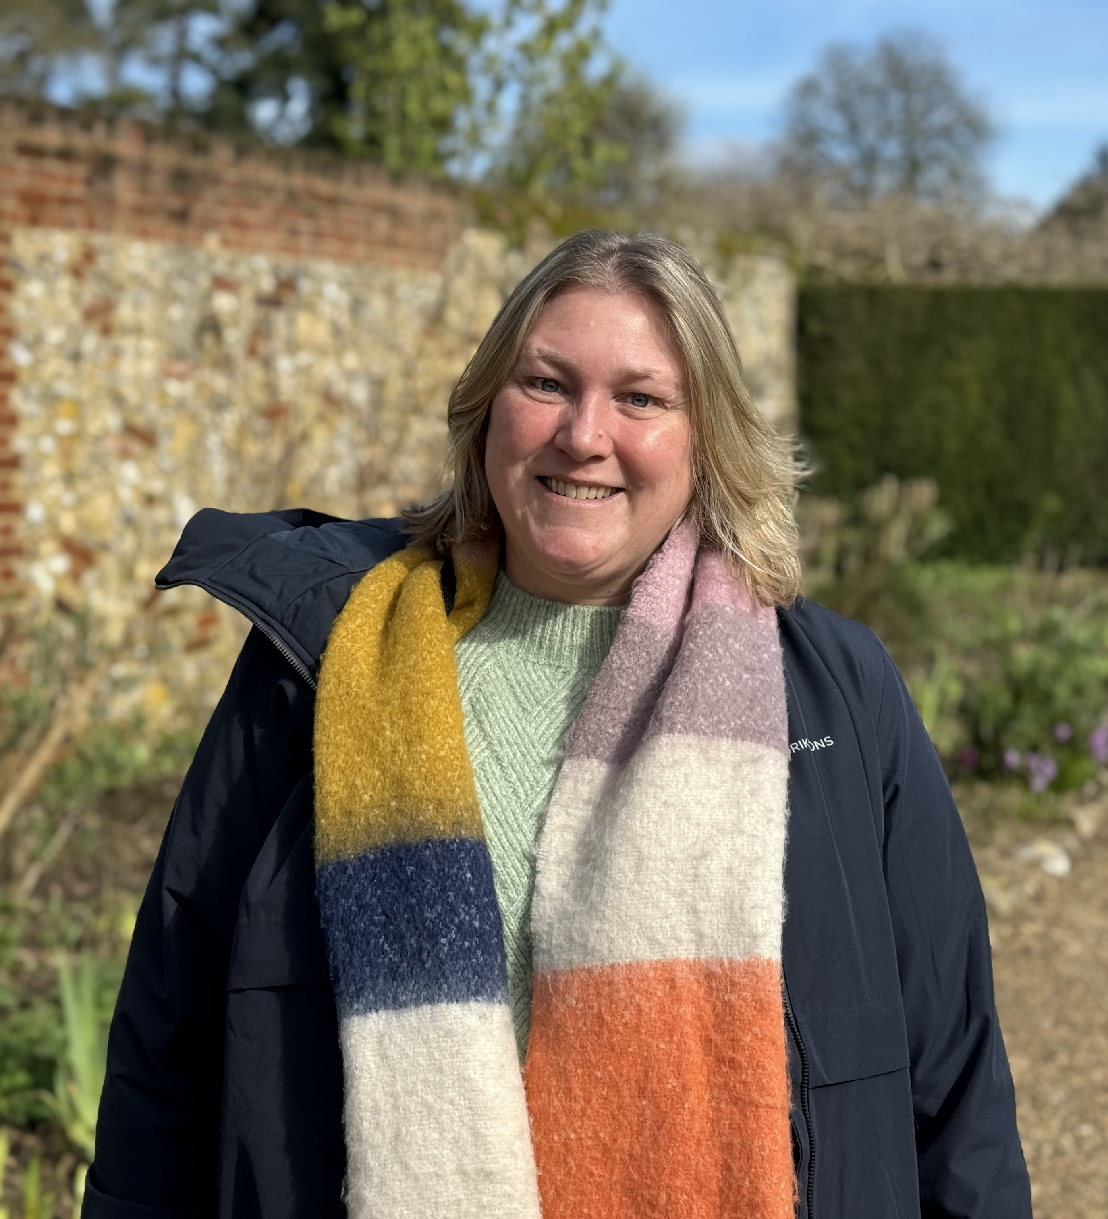
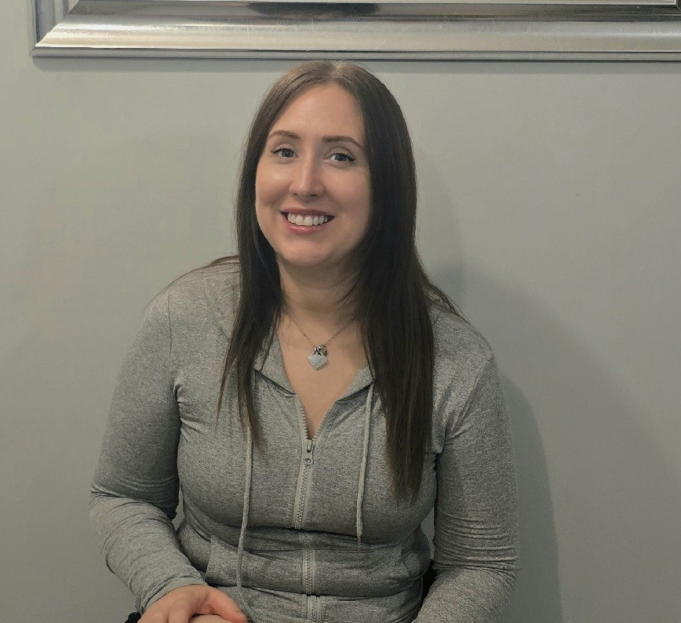
Meet the Oak Class Team
Mrs Fern
EYFS Lead and YR Teacher
Mrs Waddup
Teacher-(Wednesday, Thurs, Fri)
Miss Brown
TA-(all week)​
Miss Isaacs
TA-(Mon, Tues, Wed)

Slide 3

Attendance
Regular school attendance is essential if children are to achieve their full potential.
We believe that regular school attendance is the key to enabling children to maximise the educational opportunities available to them and become emotionally resilient, confident and competent adults who are able to realise their full potential and make a positive contribution to their community.
As a school, we class 96% or above attendance as good attendance. Attendance is monitored regularly, and support is available as needed.

Slide 4


MORNING REMINDERS
Playground gates will be open from 8.45am and will be locked promptly at 9am.
If you are arriving after this time you will need to ring the buzzer at the school office.
To encourage independence, we ask that you leave your child at the Reception cloakroom door.
Please ensure book bags, reading record books, water bottles and coats are brought in daily.

Slide 5


BREAK AND LUNCHTIMES
Children are provided with a healthy snack every day. Milk is sometimes available.
Hot dinners are available to children when requested and ordered in advance. These are free for all children in KS1 and are very tasty! They are also able to have packed lunches from home. All children sit together in the dining hall at the same time as the children in Y1 and Y2.
Healthy eating is important at our school; sandwiches, fruit or vegetables, yoghurt and a small biscuit is ample in a packed lunch. We are a nut free school – no nut products to be brought into school.

Slide 6
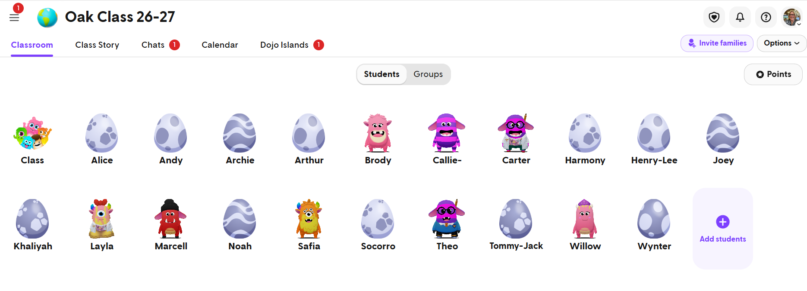
REWARDS IN THE CLASSROOM
Children in Oak Class love to receive stickers or go home with a ‘teachers note’.
Classroom rewards: Children individually work hard to earn Dojo points. Each Friday there will be a champion .
From time to time children will be nominated and celebrated in Friday assemblies by receiving a certificate from Mrs Byron.

Slide 7



IN THE CLASSROOM
Classroom Routines
Children should bring book bags each day.
Please avoid bringing in precious items from home (teddies, toys etc), they could easily get lost or broken.
Lucky Ducks – each day two ‘lucky ducks’ are chosen. The child chosen will get a sticker and be "in charge" of jobs for the day such as giving out snack, choosing some things to play with, being the line leader etc.
Medication such as inhalers/EpiPen's are kept in the classroom or in the office – please make sure we have what your child needs.
Children will bring books home from school – there is no set day to bring these back. We can change books as often or as little as suits you. Please do sign the book and we can change them as often or as little as you’d like.

Slide 8


UNIFORM
Please make sure uniform is labelled. All age4/5 jumpers look the same! A name written on the label woth a sharpie is all that’s needed!
If hair is long enough to be tied up it must be. Please can children wear plain hair bands/ clips.
PE kit needs to be worn to school on child’s PE day (Tuesday and Thursday) and MUST be clearly labelled.
Earrings must be plain studs and only one in each ear. They are not permitted to be worn during PE. For the first 6 weeks they may be covered with tape (which the child will have to apply and provide). After which, children must manage themselves.

Slide 9

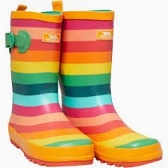
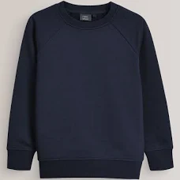
Wellies and waterproofs- Please bring a pair of wellies into school to keep at school so we can use them whenever needed. We get outside in the garden each day and will need them for Forest school. If your child also has their own waterproof trousers then these would be useful to have in school as well.
Water bottles- Please can every child have one for the classroom. We are happy to wash them out and refill them. It means there is less ‘stuff’ for the children to carry to and from school. Have a separate drink bottle for children having a packed lunch.
Jumpers- Please ensure jumpers are named! We have a jumper box in class for the children to keep them in if they are not wearing them.

Slide 10


COMMUNICATION
There is always a teacher on duty at the start of the day.
Messages may also be sent via Dojo, mainly class reminders and news of what we have been up to.
Parents can speak to staff at the end of the day. Please allow all children to be dismissed first. You can also get a message to me through the office.
Reading diaries are checked regularly. This is a good place to pass messages between home and school such as who is collecting from school.
Parent Evenings are being held on -?Nov

Slide 11



Our Learning Journey
Personal, Social and Emotional Development
Communication and Language
Physical Development
Literacy
Maths
Expressive Art and Design
Understanding the World
“Play is the work of a child!” _ Maria Montessori

Slide 12

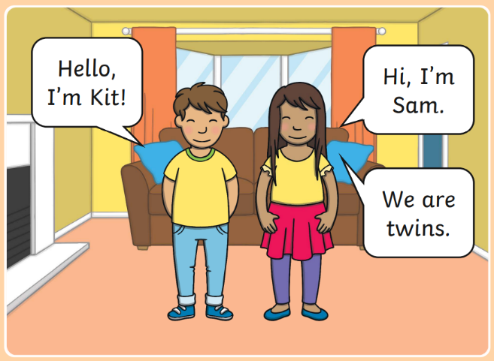

Phonics and Reading
Phonics and reading will take place every day at school. We begin by learning Level 2 Phonics following the Twinkl scheme.
From time to time, you will receive a parent pack home. This will show you which letters/ sounds your child has been exposed to that week. Each sound comes with an action. We encourage lots of practise at home to maximise progress.
Your child will begin reading with Rhino Readers. These books will be sent home weekly. The scheme is designed to improve fluency.
Your child will move up a level when they are reading fluently, with comprehension and have been exposed to the appropriate sounds.

Slide 13
Assessment
There are no formal assessments for EYFS.
EYFS will have a baseline assessment at the very start of their school life.
Your child will be assessed through teacher observation over the year and be graded with GLD (good level of development). You will receive this information in their end of year school report.

Slide 14
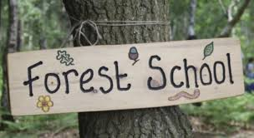
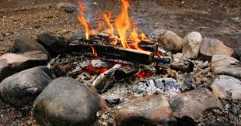
Forest School
Your child will be attending Forest School.
This will be each Wednesday as part of the school day for the time being.
More and more schools are now offering outdoor learning sessions for children and there is lots of evidence that spending time in nature is key to supporting high levels of wellbeing for both children and adults.
You may already be aware that a corner of the field is being developed into a nature area. This will become a space for the children to learn while they are outside, spending some time in nature.

Slide 15

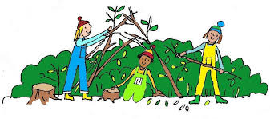
Children benefit from a forest school experience because it allows them-
Forest School
Time to …
explore and experiment at their own pace
become engrossed in their own activities
observe and learn about the natural world
extend on classroom-learning
Opportunities to …
problem solve
take risks within a safe environment
make mistakes and learn from them
develop resilience, perseverance and empathy
take control of their own learning.
Space to …
work through their own thoughts and ideas independently.
work together on small or large common goals and projects.
Learn and apply social skills such as conflict resolution, compromise, diplomacy and negotiation.
Be physically active for an extended time
… and, of course, it’s also all about having fun together, being creative and using our imaginations,

Slide 16

WOW moments!
We would love to share your child’s learning with you throughout the week.
Regularly, messages will be posted on our Dojo story informing you of what we have been up to and what is coming up.
Please respond to your dojo invitation that will have come in an email, if you haven't already done so.
Please do see us if we can help with accessing Dojo.
Messages can be sent on DOJO, however, we are not always able to respond.

Slide 17



HOMEWORK
““The more that you read, the more things you will know. The more that you learn, the more places you'll go.”
― Dr. Seuss
Daily reading homework
Talk time- daily chats with your children about their day and what they have been learning really help your child's learning and development.

Slide 18
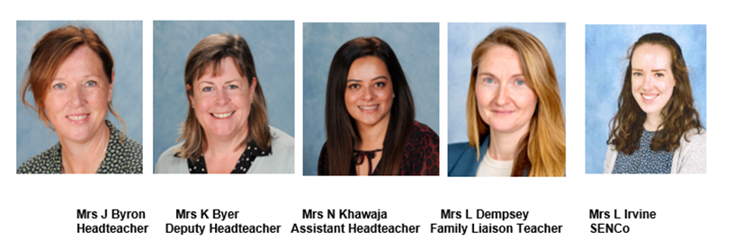
Safeguarding
The Designated Leaders for Safeguarding (DSL) are Mrs Jane Byron, Mrs Karen Byer, Mrs Nazia Khawaja and Mrs Lisa Dempsey are additional DSLs.
At Foxes Piece, the health, safety and well-being of every child is of paramount concern. We listen to our pupils and take seriously what they tell us. Our aim is that children will enjoy their time as pupils in our school.
We want to work in partnership with everyone to help children achieve their full potential and make a positive contribution.
For all safeguarding related queries please email -
safeguarding@foxespiece.co.uk

Slide 19
Thank you for attending today!
If you would like to volunteer to work at Foxes Piece, please contact the school office. We are always very appreciative of any extra help!
We look forward to working with you and your children this year.

