Slide 1
WELCOME TO YEAR 1 !
Ash Class
Miss Grimsdell

Slide 2
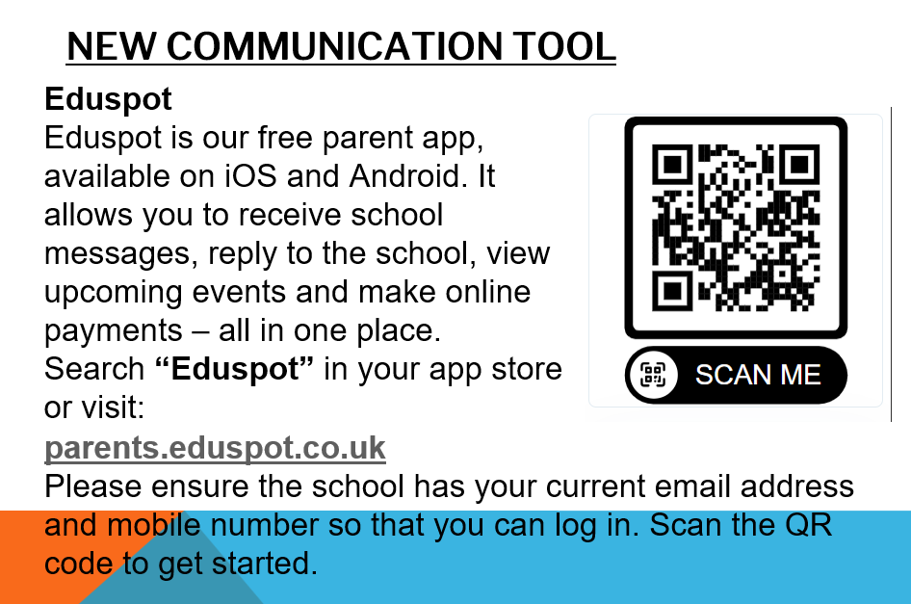

Slide 3

ADULTS IN THE CLASSROOM
Miss Grimsdell (Class Teacher)
Mrs Pluck
Miss Gac

Slide 4
SCHOOL VALUES
Our vision and values are at the core of everything we do. They underpin our teaching and learning and provide an environment which prepares our pupils as confident, happy citizens.
Mission Statement - to provide the highest quality all round education, for each and every child, in partnership with parents, within our diverse community.
Aim - To create a happy, safe and curious learning community.
Purpose/Vision - At Foxes Piece School pupils will leave resilient, confident, respectful and independent young people, ready for their next step in education.
Resilience, Equality, Independence, Respect, Perseverance.

Slide 5

MORNING REMINDERS
The playground gates will be open from 8.45am and will be locked promptly at 8:55am. If you are arriving after this time you will need to ring the buzzer at Reception.
As soon as the children arrive, they should proceed to their classroom where their teacher will be waiting with morning work to complete.

Slide 6

ATTENDANCE
Regular school attendance is essential if children are to achieve their full potential.
We believe that regular school attendance is the key to enabling children to maximise the educational opportunities available to them and become emotionally resilient, confident and competent adults who can realise their full potential and make a positive contribution to their community.
As a school, we class 96% or above attendance as good attendance. Attendance is monitored regularly and support is available as needed.

Slide 7

BREAK AND LUNCHTIMES
Fruit is available in the dining hall at break times. Children can bring in their own healthy snack.
Hot dinners are available to children when requested and paid for in advance. They are also able to have packed lunches.
Healthy eating is important at our school; sandwiches, fruit or vegetables, yoghurt and a small biscuit is ample in a packed lunch. We are a nut free school.

Slide 8

IN THE CLASSROOM
Rewards - Marbles towards a whole class treat, verbal praise, certificates in weekly sharing assemblies, desk guest (toy fox), star of the week, proud of you tickets and Dojos.
Sanctions – Clear, consistent consequences. "Flip the pancake" cards.
Classroom jobs
Water bottles - named please
Medication (inhalers/EPI pens to be named and dated)

Slide 9

UNIFORM
Clothing should be clearly labelled
PE kit needs to be worn to school on Tuesdays and Fridays
Long hair should be tied up using plain hairbands and clips
Earrings must be plain studs and only one in each ear. These should be taped on PE days.

Slide 10

COMMUNICATION
Reading diaries will be checked by an adult in school – if you write a message in there, make sure your child lets us know.
There is always a teacher on duty at the start of the day.
Parents can always speak to me at the end of the day or get a message to me through the office.
Do we have your up-to-date contact details?

Slide 11

HOMEWORK IN YEAR 1
Reading is an incredibly important skill for children to have and, as always, practice makes perfect! Please try to read with your child every night and record it in their reading diary.
A piece of Maths and/or English homework will be set on a Friday. This work is due in on the following Wednesday. These tasks will be appropriate for your child and should only take 20 minutes each. They may also have a handwriting letter to practice. This will be written in their homework books.

Slide 12
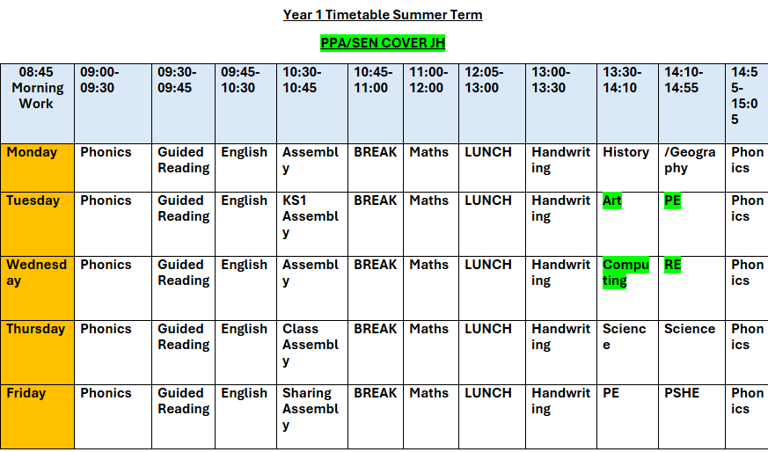
TIMETABLE

Slide 13

MATHS
Daily Maths lessons following the White Rose scheme. We work hard to challenge and support each child.
Challenge and problem-solving questions are included in Maths lessons and linked to everyday situations e.g money, time, weighing and measuring.
Lots of different equipment in the classroom for the children to use.
Number facts to be practised at home if possible.

Slide 14

ENGLISH
Daily English lessons following Ready, Steady, Write scheme.
Daily Guided Reading sessions in pairs.
We work hard to challenge and support each child.
We put a strong emphasis on presentation and encourage all children to take pride in their work.
Grammar and punctuation teaching is implemented throughout English lessons.
Handwriting is taught using the Kinetic Letters scheme.

Slide 15

READING
Please read with your child every day. Reading books are changed by us on a Friday. They need to be in school every day.
We are continually assessing children’s reading to ensure they are at the correct level.
If you would like to be a reading helper or would like support with reading strategies for your child, please get in touch.
Please encourage your child to read at home to develop their love of reading.

Slide 16

TRIPS
You will be sent the dates for upcoming trips as soon as they are confirmed!
Toy workshop visit to school (Wycombe Museum) during Autumn term

Slide 17
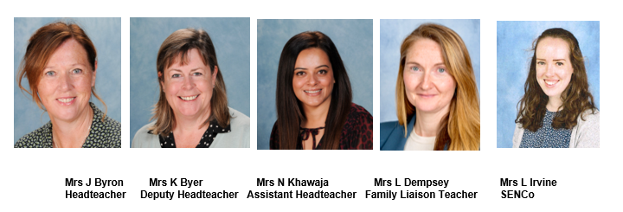
SAFEGUARDING
The Designated Leaders for Safeguarding (DSL) are Mrs Jane Byron, Mrs Karen Byer, Mrs Nazia Khawaja and Mrs Lisa Dempsey are additional DSLs.
At Foxes Piece, the health, safety and well-being of every child is of paramount concern. We listen to our pupils and take seriously what they tell us. Our aim is that children will enjoy their time as pupils in our school.
We want to work in partnership with everyone to help children achieve their full potential and make a positive contribution.
For all safeguarding related queries please email -
safeguarding@foxespiece.co.uk

Slide 19

THANK YOU!
If you would like to volunteer to work at Foxes Piece, please contact the school office. We are always very appreciative of any extra help!
Any questions?
I am looking forward to working with your children and making both great progress and fantastic memories across the year. Thank you for coming!

