Slide 1





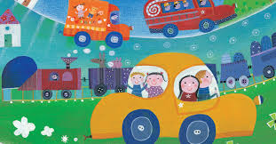
Reception NEWSLETTER
Autumn Term
9th September: Meet the Teacher 3.30pm to, 5.00pm
h September: School Photographer in school (classes, individual and siblings)
Friday 23th October: Children break up for Half Term
Wednesday 5th November: Fireworks event
Nov: parent evenings
Nov: Mini-bus Trip TBA
Dec: Nativity Play
18th Dec: Christmas jumper day
Upcoming Events
PE is on Tuesdays and Thursdays.
Forest School is onWednesday- please send children in trousers, leggings/joggers are great.
Bring book bags to school each day and look at Dojo.
Unmissable Mondays and fun Fridays this term may include: -
. Arts and crafts
.dancing
.climbing wall and much more
Reminders
Curriculum News
Our topics are ‘Marvelous me' and 'transport’.
This half term we will be exploring the following-
Our Faces
Our homes and families
My environment around me
People who help us
How our bodies work
Exploring Autumn through our senses.
After half term we will be focusing on transport, old and new and all the different types. What is the best way to travel? And what journeys have we been on?
Of course, we will also be learning about Christmas and celebrating this with our end of term Nativity play.
The children will also become outdoor explorers at our weekly forest school session each Wednesday.
We will be learning through play and developing many new learning skills. It's an exciting time of year to be in Reception.
We will begin learning Phonics this month using twinkl phonics and meeting the characters Kit and Sam and Ben the dog.

