Slide 1
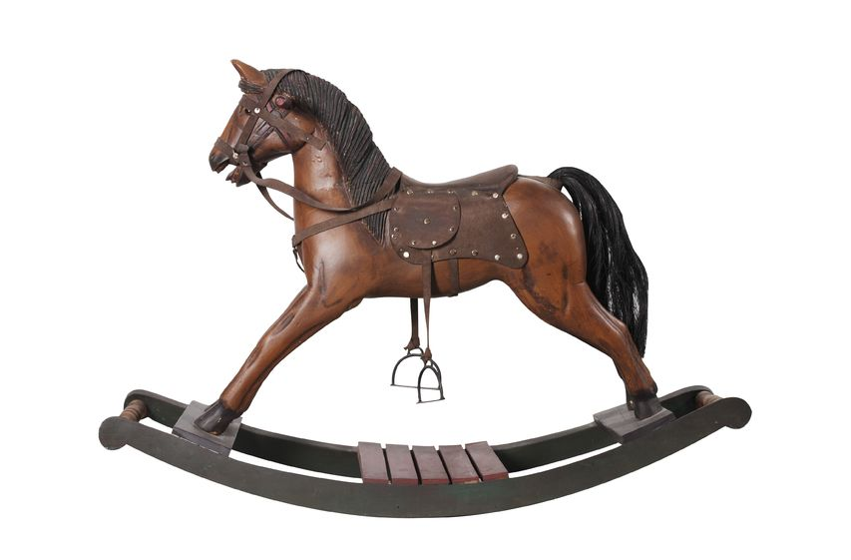

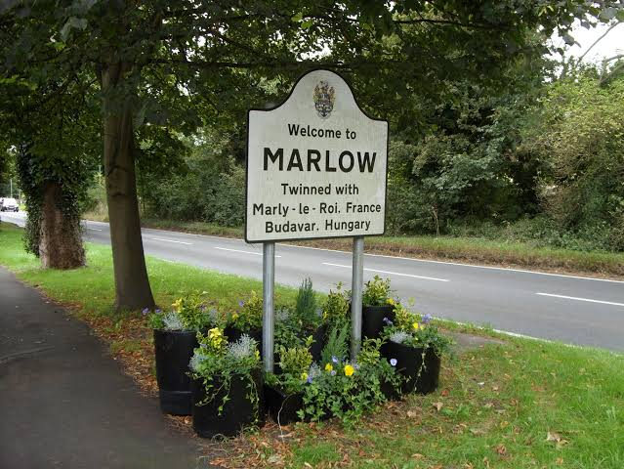
Year 1 NEWSLETTER
Autumn Term
Upcoming Events
Wednesday 9th - Meet the Teacher 3.30pm until 5pm
Wednesday 23rd - Flu Immunisations for whole school
Monday 28th - School Photographer in school
Thursday 5th – Fireworks Event
Friday 13th – Children in Need
Wednesday 18th – Parent Interviews 3.30pm-7pm
Thursday 19th – Parent Interviews 3.30pm – 5pm
Tuesday 8th – EYFS and KS1 Nativity Play (2pm)
Wednesday 9th – EYFS and KS1 Nativity Play (10am)
Friday 18th – Christmas jumper day/class parties in class
Friday 18th – Break up for Christmas at 1pm
Homework:
Homework will be set on a Friday and should be returned the following Wednesday.
PE:
PE days are Tuesdays and Fridays. Please ensure earrings are either removed or securely taped on these days.
Uniform and Water Bottles:
A gentle reminder to please label all uniform and water bottles clearly with your child’s name to help us return any misplaced items.
Reminders
Topic
Our topic focus will be on 'Toys Over Time' and 'Our Local Area'.
Reading and Writing
This term we will be reading Old Bear and Rapunzel. We will be writing stories, recounts and instructions.
Maths
This term we are focussing on counting, addition and subtraction to 20, and learning the shape names.
Science
In Science we will be learning:
•'All About Us'
•'Seasonal Changes'
Handwriting
Handwriting will be a key focus for Year One.
Curriculum News

