Slide 1

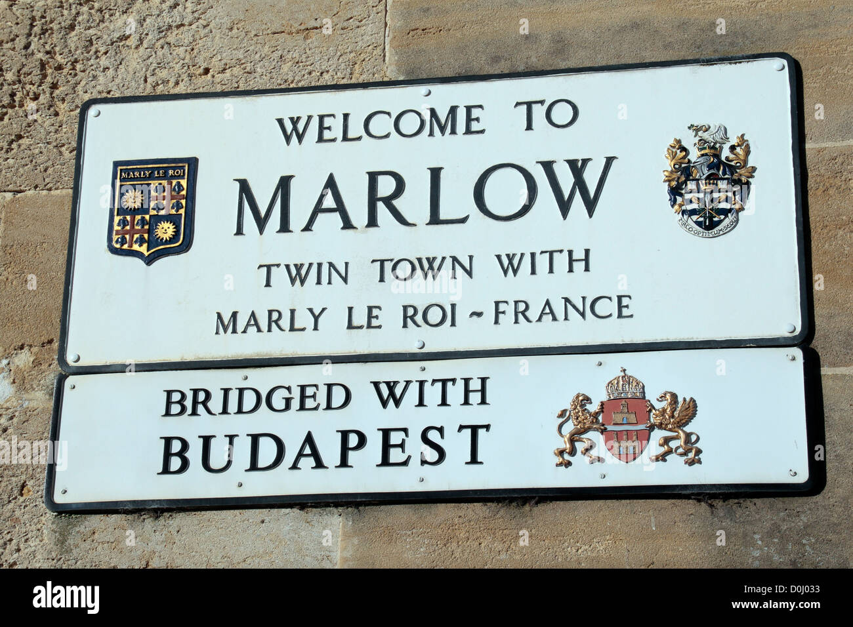
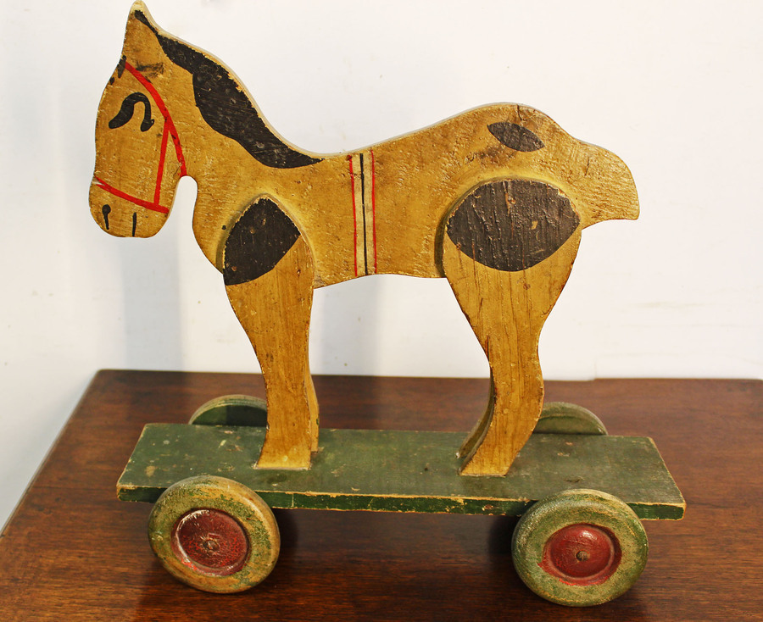
Year 2 NEWSLETTER
Autumn Term
Wednesday 9th September – Meet the Teacher
Monday 29th September – School Photographer in school (classes, individual and siblings)
Friday 23rd October – Children break up for Half Term
Wednesday 18th November – Parent Interviews 3.30pm-7pm
Thursday 19th November – Parent Interviews 3.30pm – 5pm
Tuesday 8th December – Nativity Play (2pm)
Wednesday 9th December – Nativity Play (10am)
Homework:
Homework will be set on a Friday and should be returned the following Wednesday.
Reading books will be changed on a Friday. Please read daily with your child and sign their reading record.
PE:
PE days are Mondays and Fridays Please ensure earrings are either removed or securely taped on these days.
Uniform and Water Bottles:
A gentle reminder to please label all uniform and water bottles clearly with your child’s name to help us return any misplaced items.
Upcoming Events
Reminders
Topic
Our topic focus will be on ‘Toys' and ‘Our Local Area'.
Reading
Our class novel for whole class reading will be ‘Charlie Changes into a Chicken’ the first term and ‘The Legend of Spud Murphy’ the second term.
Writing
We will be writing a narrative and letter based on the text ‘A River’ during the first term, followed by writing a setting narrative and diary based on the ‘The Night Gardener’.
Handwriting
Clear and concise letter formation will be the focus the first half term, moving towards joins the second half term.
Maths
We will be focusing on Place Value, Addition & Subtraction and Shape.
Science
In Science we will be learning:
• Uses of everyday materials.
• Living things & their habitats
Curriculum News

