Slide 1
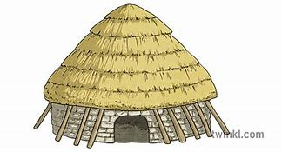

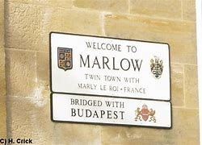
Year Three NEWSLETTER
Autumn Term
Wednesday 9th September – Meet the Teacher 3.30pm to 5pm
Wednesday 23rd September – Flu Immunisation for the whole school
Monday 28th September – School Photographer
Wednesday 21st October – Trip to Pitts Rivers Museum
Friday 23rd October – Children break up for Half Term
Thursday 5th November – Fireworks Event
Friday 13th November- Children in Need
Wednesday 18th November- Parent Interviews 3.30pm-7.00pm
Thursday 19th November- Parent Interviews 3.30pm- 5.00pm
Friday 18th December- Christmas jumper day
Friday 18th December- Break up for Christmas at 1pm
PE:
PE takes place on Mondays and Fridays. Please ensure earrings are either removed or securely taped on these days and long hair is tied up.
Homework:
Homework will be set on Friday and should be returned by Wednesday. Children will receive one piece of Maths and one piece of English to help consolidate their learning in school.
Reading Books:
Reading books are changed every Friday or as required. Please ensure they are brought into school daily.
Uniform and Water Bottles:
A gentle reminder to please label all uniform and water bottles clearly with your child’s name to help us return any misplaced items.
Upcoming Events
Reminders
Our topics are 'Stone, Bronze and Iron Age' and 'Our Local Area'.
Reading and Writing
In our Reading lessons, we will be exploring The Worst Witch and Amelia Fang and the Barbaric Ball. During our Writing lessons, we will be studying The Iron Man and Fox, writing our own story and information report.
Maths
This term we are focusing on Place Value using numbers up to 100 to add and subtract. We will also be learning our 3 and 6 times tables.
Science
In Science, we are learning about Animals including Humans. We will focus on the human body and what it needs to survive.
Handwriting
We are now writing with handwriting pens. We continue to use the Kinetic Letters handwriting programme to learn to join our handwriting.
Curriculum News

