Slide 1


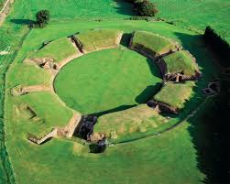
Year Four NEWSLETTER
Autumn Term
PE is on Monday & Friday.
Homework will be set on Fridays and should be handed in by Wednesdays each week.
This will include:
Maths – Set on Doodlemaths
English – Reading or writing, set in homework books
Spellings – Set in spelling book.
The children should also be reading at home each day – please sign their reading records and completing at least one soundcheck a day on Times Table Rock Stars.
Passwords will be stuck into the front of their homework books
Reminders
Wednesday 9th September – Meet the teacher, 3.30pm-5pm
Wednesday 23rd September – Flu Immunisations
Monday 28rd September – School photographer
Friday 23rd October – Children break up for school
Wednesday 18th November - Parent interviews 3.30pm-5pm
Thursday 19th November – Parent Interviews 3.30pm-5pm
Friday 11th December – Christmas Market
Friday 18th December - Christmas jumper day, break up for Christmas.
Upcoming Events
Our topics are 'Romans' and 'Roman Britain’
Reading and Writing
Our class novel is The Girl Who Stole an Elephant.
Our writing text is The Whale. The children will write a newspaper article about a rare species and create a narrative about children embarking on a search for a whale.
Maths
We are focussing on place value, addition & subtraction and multiplication this term.
Science
This term, our topic is Animals Including Humans. The children will learn about teeth and the digestive system.
Handwriting
Handwriting is a key focus across the school and will continue to work with the children to form letters correctly.
Curriculum News

