Slide 1
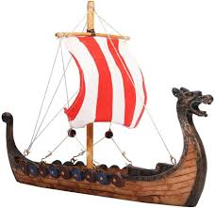


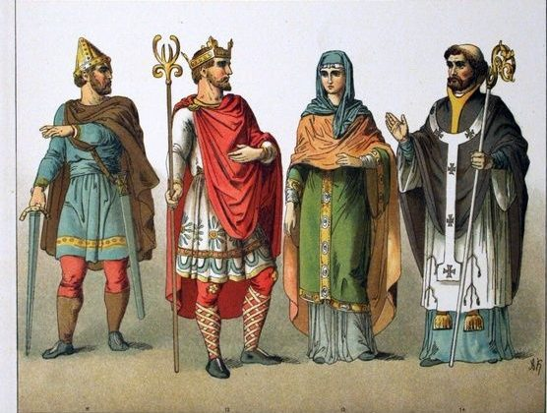
Year Five NEWSLETTER
Autumn Term
Swimming starts – Wednesday 9th September.
Wednesday 9th September – Meet the Teacher 3.30pm to 5pm​
Wednesday 23rd September – Flu Immunisation
Monday 28th September – School Photographer​
Friday 23rd October – Children break up for Half Term​
Thursday 5th November – Fireworks Event​
Friday 6th November – Chiltern Open Air Museum trip
Friday 13th November- Children in Need​
Wednesday 18th November- Parent Interviews 3.30pm-7.00pm​
Thursday 19th November- Parent Interviews 3.30pm- 5.00pm​
Friday 18th December- Christmas jumper day​
Friday 18th December- Break up for Christmas at 1pm​
Swimming is on Wednesday. Please wear your swim outfit underneath your PE kit on swimming days. Your swim bag must include a towel, swim hat and clean underwear for after swimming. Goggles are optional.
PE is on Thursday. Please wear your PE uniform into school.
Homework will be handed out on Fridays and will be due on Wednesdays.
Please ensure all uniform is labelled.
Rowan Class
Upcoming Events
Reminders
Our history topic is 'Anglo Saxons' and 'Vikings’.
We will understand the chronology of the eras, what life was like and gain an understand of the important people who were alive at the time whilst using historical language.
Reading and Writing
Our class novel for the term is Crater Lake by Jennifer Killick.
Our English unit for the first half of term is ‘Exploration Narrative’ which will focus on the book ‘When We Walked on the Moon’ by David Long and Sam Kalda. In the second half of the term, our unit is ‘Setting Narrative’ which will focus on the book ‘FaRther’ by Grahame Baker-Smith.
Maths
This term, we will learn about place value to 10,000, addition and subtraction and multiplication and division with 4-digit numbers and fractions.
Science
We will learn about Earth and Space in the first half term and Forces in the second half of the term.
Handwriting
Using our scheme, Kinetic Letters, we will be focusing on our writing position, pencil grip and the formation of different letter families.
Curriculum News

